Slide 1
Starting at 10:00 AM (EST)
PONI Winter Conference
Nuclear Lessons Learned From the Ukraine Conflict
February 26, 2024
Learn more about the Project on Nuclear Issues at the
Next Generation Nuclear Network
nuclearnetwork.csis.org

Slide 2
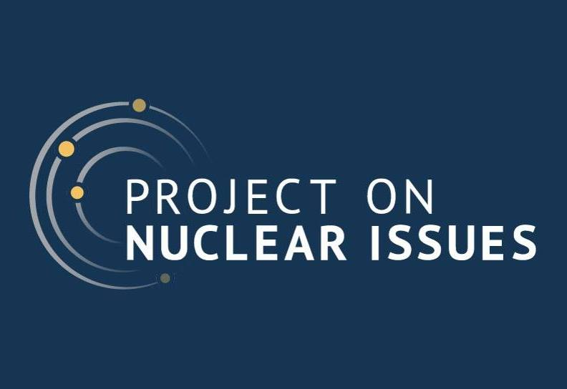
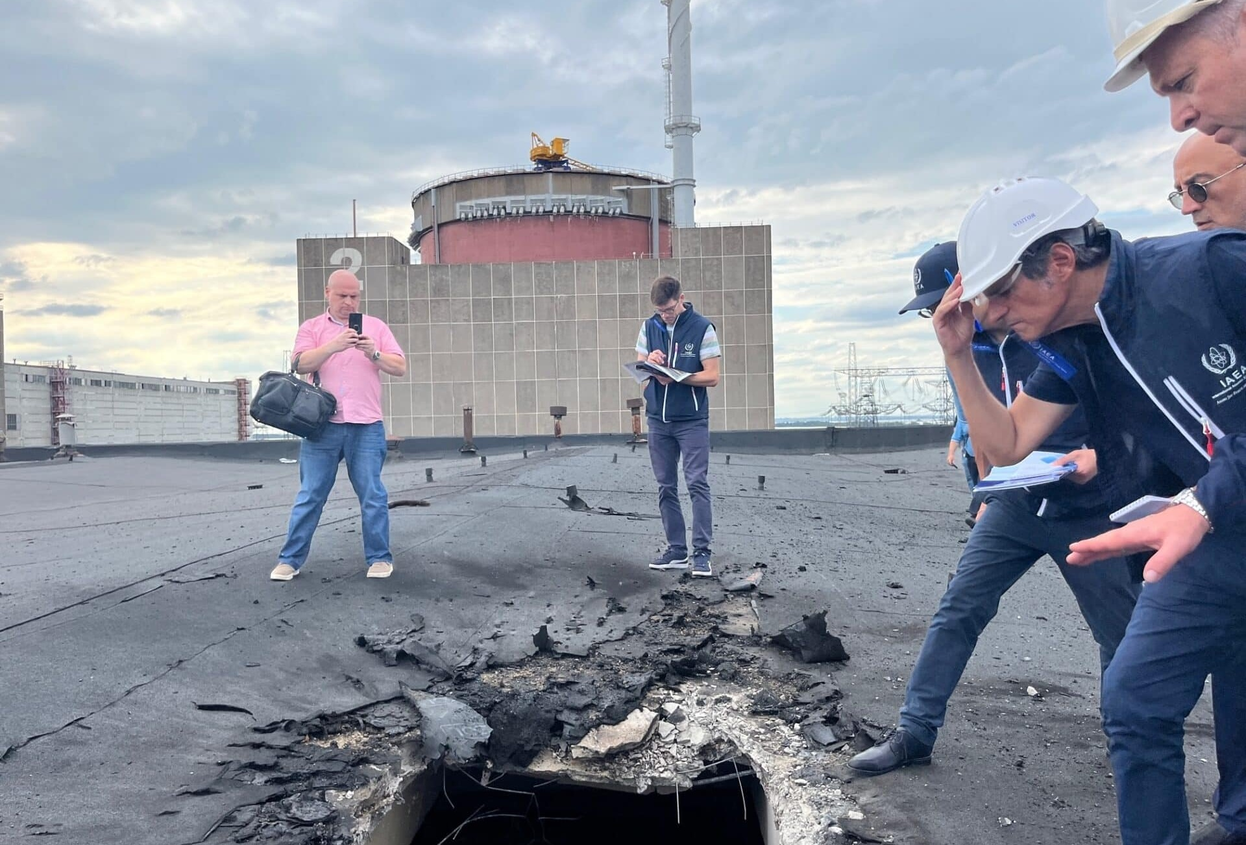
Nuclear Security after the Russian Invasion of Ukraine
Ali Alkis WINS Ambassador to Turkiye & PhD Candidate

Slide 3
Outline
Nuclear Security and its evolution
Overview and Analysis of Russian Occupation of Ukrainian NPPs
Potential Consequences of Armed Attacks against NPPs
Recommendations

Slide 4
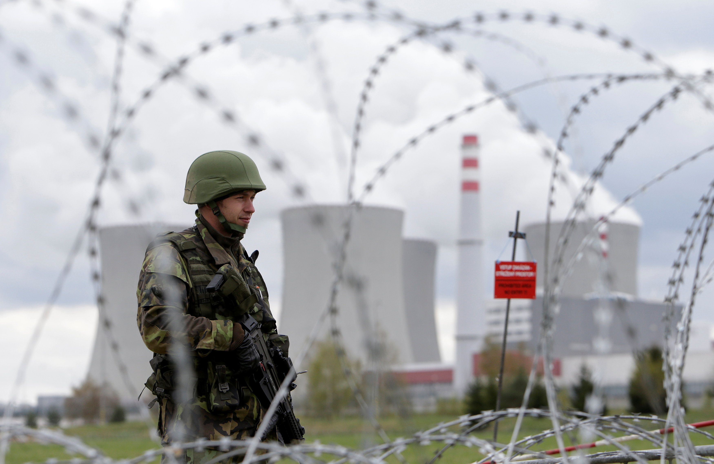
Introduction
Protection of nuclear materials and facilities to prevent malicious human actions.
Increasing focus on terrorism after 9/11.
Explicit recognition of state actor as a threat
Not effective against today’s threats.

Slide 5
Research
How should the international nuclear security regime respond to changing threats?
A more robust international framework with measures at institutional and operational levels.
Nuclear Security protocol
Nuclear Security zone

Slide 6
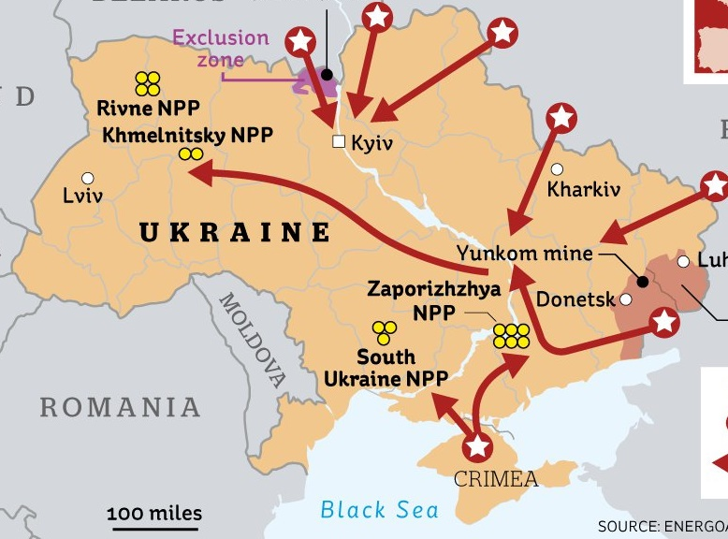
Overview of facilities since February 2022
Temporary occupation of the Chornobyl and the ongoing occupation of the Zaporizhzhia.
Attempted occupation of the Pivdenny.
Russian forces unable to occupy the Pivdenny but ongoing sabotage attempts.
The situation at Zaporizhzhia with “very real” potential dangers of a major accident.

Slide 7
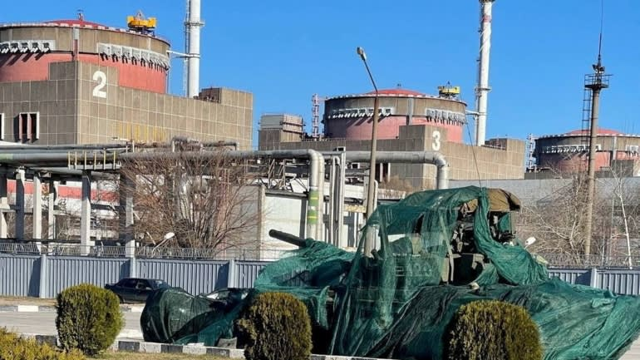
Zaporizhzhia NPP
A war in a state with advanced and operational nuclear infrastructure.
Previous military attacks on nuclear facilities were not operational.
An ongoing conflict in and around nuclear facilities:
tanks,
heavy weaponry, and
constant shelling.
Operating personnel has been detained and forced to work.

Slide 8
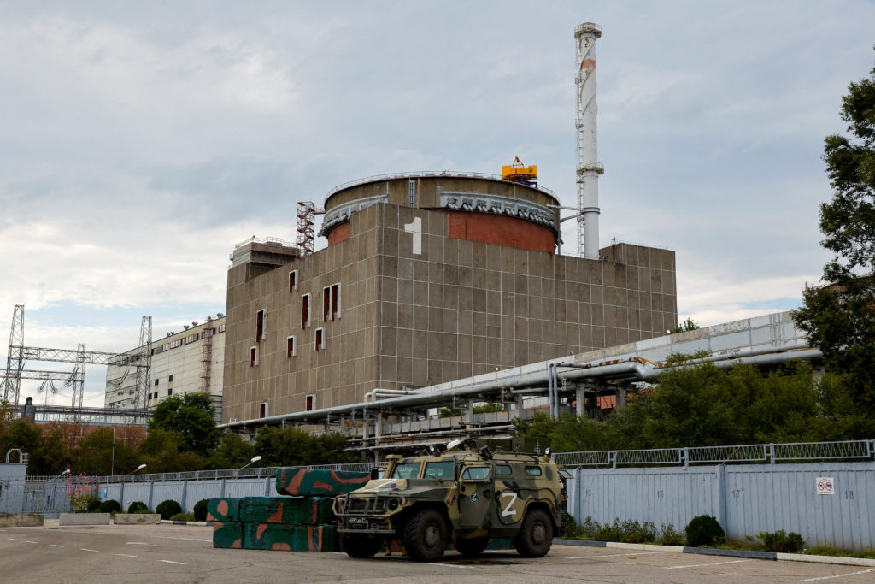
Zaporizhzhia NPP
The prolonged attacks on the facility:
physical integrity of facilities;
functionality of safety and security systems;
logistical supply chains;
emergency preparedness, and response measures; and
communication with the regulator and the IAEA.

Slide 9
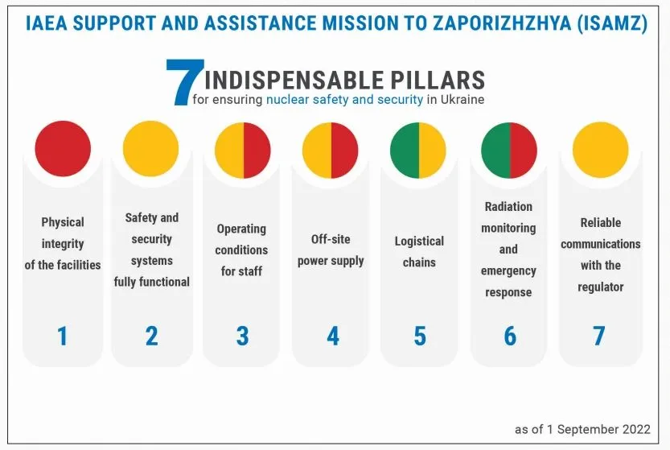
Zaporizhzhia NPP
The current status at the facility:
DG Grossi visited it 4 times.
16 IAEA missions since September 2022.
5 reactors in cold, Unit 4 in hot shot down.
inadequate staff, and no maintenance plan.

Slide 10
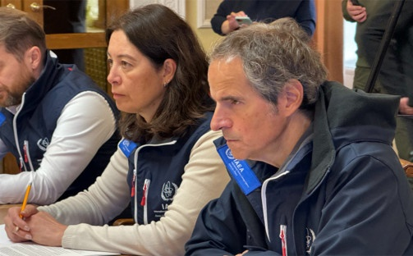
New Risks and Challenges
Russian occupation as an unprecedented gap.
Deliberate hostile action possibly resulting in life-threatening radiological releases.
An entirely new type of risk.
Russia continues to attack, shell, mine, occupy, and operate it.
An instrument of coercion.

Slide 11
Potential Consequences
Risk of a cross-border release of radioactive material.
The potential consequences are severe.
Technically possible core meltdown and containment breaches:
death and illness,
contamination of agricultural land and water supplies, and
disruption of transportation and communication networks
damage to the credibility of nuclear power.

Slide 12
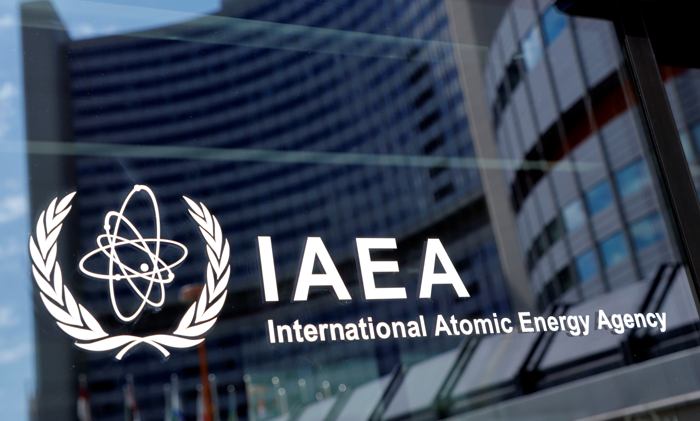
Recommendation at the institutional level
IAEA with a nuclear security and safety protocol.
IAEA with limited authority to manage wartime threats.
Bypass the challenges of gaining the consent of states.
IAEA mission to be legally empowered under military protection:
in the territory of the host state,
to monitor and report nuclear safety and security,
as an impartial international authority.

Slide 13
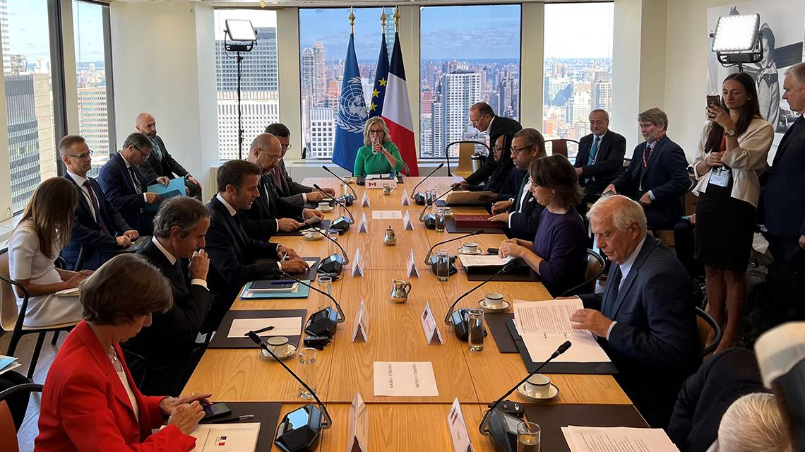
Recommendation at the operational level
A nuclear safety and security protection zone as interim measure.
no attacks from and to nuclear facilities.
Ensuring the physical integrity of facilities.
Reinforcing the IAEA’s seven pillars until a political solution is found.
The modalities to be negotiated at the IAEA Board of Governors for future emergencies.

Slide 14
Conclusion
Expected expansion of nuclear facilities to new states.
Preventing where possible and otherwise managing wartime threats.
Lessons learned from Ukraine for similar events in the future.
Possible nuclear incidents with radiological consequences.
NPPs must be kept safe and secure, including during military conflict.

Slide 15
Thank you for your attention!
alialkis@hacettepe.edu.tr
Ali Alkis
@AliAlkisTR

Slide 16
PONI Winter Conference
Nuclear Lessons Learned From the Ukraine Conflict
February 26, 2024
Learn more about the Project on Nuclear Issues at the
Next Generation Nuclear Network
nuclearnetwork.csis.org

Slide 17
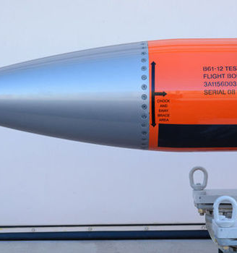
(New) Materials of Deterrence? Thinking NATO Nuclear Deterrence through the new B61-12
Vincenzo Poti
MISS, University Of Trento – Sant’Anna School of Advanced Studies
potiv@outlook.it – X: @PotiVincenzo
PONI 2024 VIRTUAL WINTER CONFERENCE

Slide 18
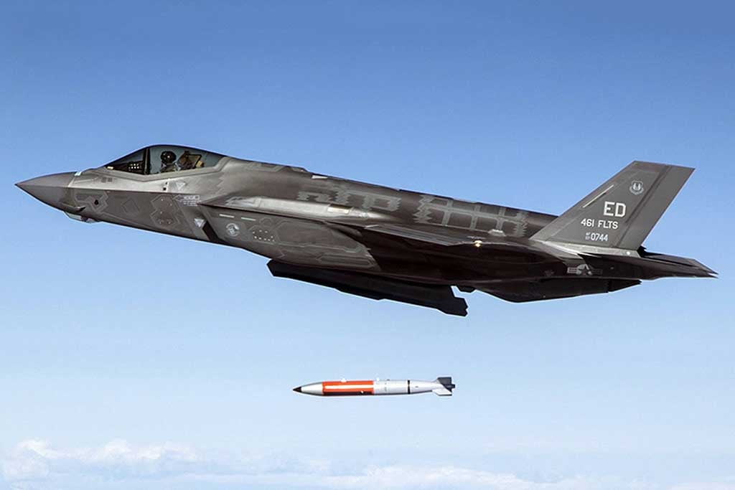
How do new B61-12 bombs ‘co-produce’ NATO nuclear deterrence vis-à-vis Russia?
The crystallization of the current ‘well-being’ of the Alliance through its ‘inscription’ in the B61-12/F-35A composition
Deterrence as an inward-looking rationality rather than an outward-looking strategy within NATO
Shifting deterrence value of ‘tactical’ nukes with the war in Ukraine

Slide 19
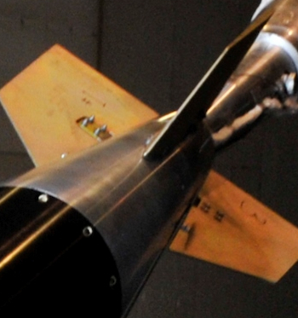
Outline
Setting the scene
Relevance of the research
Theoretical framework and methodology
The B61-12/F-35A system
Key findings

Slide 20
The Guardian
Oct 5, 2022
AP
Aug 22, 2023
Lockheed Martin
Modern Diplomacy
Aug 16, 2023

Slide 21
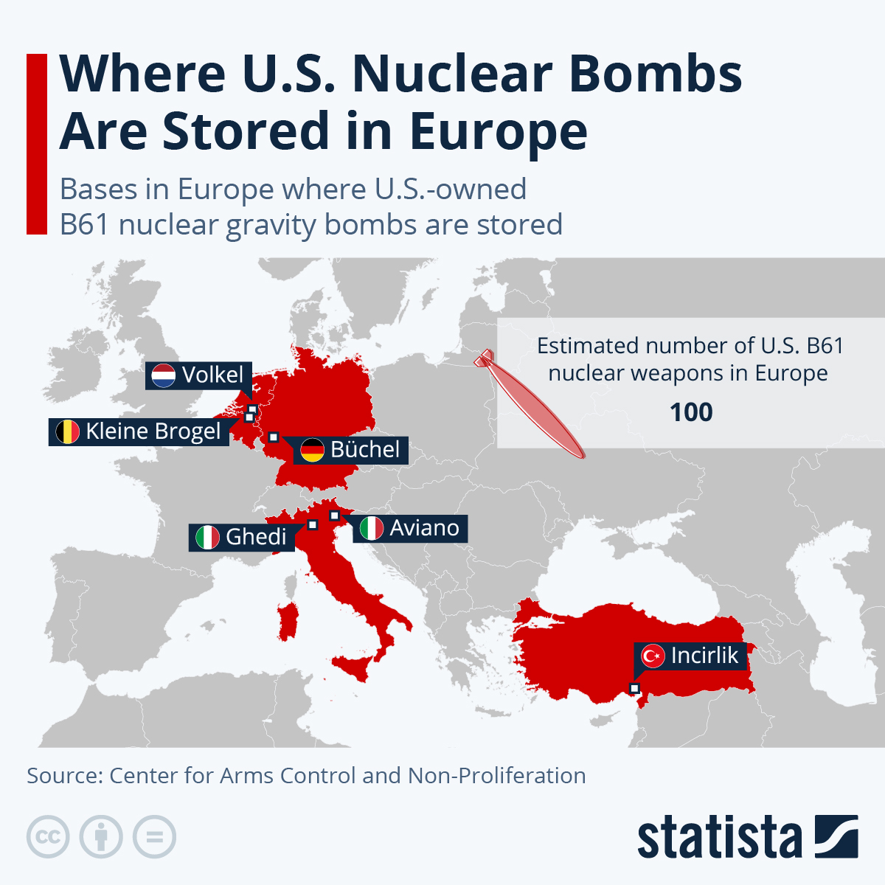
Re-thinking deterrence through its components
Security and technology: between determinism and a more ‘critical’ view
Re-politicizing NATO nuclear sharing
Enriching perspectives on post-war scenarios
Nuclear modernization and shifting logic of ‘tactical’ nuclear (non-)use

Slide 22
Theoretical orientation: key points
Material-semiotic approach (Latour, 1990): translation (not a smooth transmission) of programs of action → the agency of the ‘material load’: action as a technopolitical composition – the role of the unintended
‘Critical’ view of nuclear weapons (Wyn Jones, 1999): technologies are neither neutral tools in the hands of humans (e.g. Mao Zedong) nor the structural determinants of human relations (e.g. Kenneth Waltz) → ambivalent nature and composition of action/power
Nukes as ‘materials of practice’ (Pouliot, 2010): the embodiment of intersubjective meanings of rivalry and deterrence logics – emergence and maintenance of commonsensical (?) assumptions
See also Walters (2002)

Slide 23
‘Pinboard’ methodology (Law, 2002)
Collecting bits of information and connecting them
A messy representation of a messy sociotechnical reality
Looking for associations: description/interpretation over explanation
Heterogeneous sources – follow the objects

Slide 24
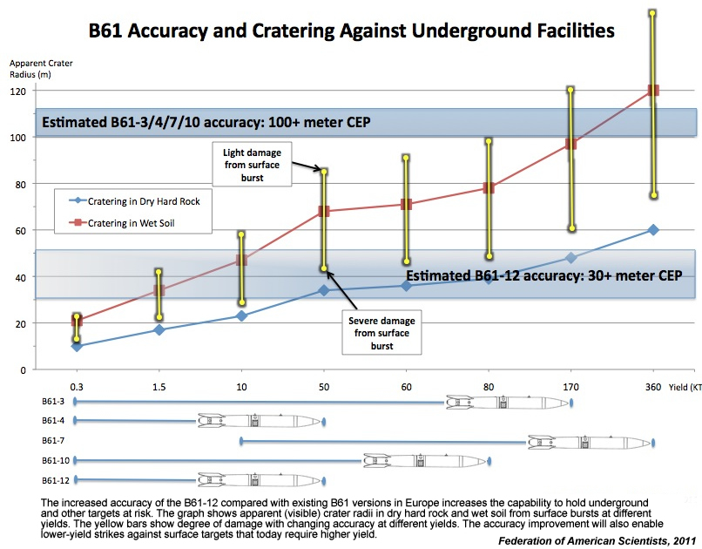
B61-12 (2021): what’s new?
0.3, 1.5, 10, or 50 kt
400+ weapons planned (?)
Internal Navigation System (INS) + Tail Kit Assembly (TKA)
Down to a CEP of 30 metres → «Improved accuracy and lower yield are desired military capabilities» and «benefits from an employment standpoint» (Gen. Schwarz, 2014)

Slide 25
Nuclear Posture Review 2022
«To deter theater attacks and nuclear coercion of Allies and partners, we will bolster the Triad with capabilities that further strengthen regional deterrence, such as F-35A dual-capable fighter aircraft (DCA) equipped with the B61-12 bomb.
[Making nuclear deterrence in Europe strong and credible] includes modernizing U.S. nuclear weapons forward-deployed in Europe and, with participating NATO Allies, transitioning to a new generation of fighter aircraft, including the U.S. F-35A Joint Strike Fighter.»
The introduction of B61-12 is framed as a way of reinforcing extended deterrence, but its new capabilities make this questionable.

Slide 26
From weapon systems to ‘weapons-systems’ (Bourne, 2023)
The politics of objects: INS-JSF software compatibility
From ‘dumb’ bombs to ‘smart systems’: integrating the F-35A and the B61-12
Weapons as technopolitical assemblages
«What makes U.S. strike aircraft especially formidable is the surrounding stuff—assets such as ballistic and cruise missiles plus countless force enablers (…), interlinked information and communication systems, the ability to generate and sustain the use-of-airspace deals on relatively short notice, and so on. (…) Air-strike capability enables U.S. airpower materially, but, perhaps more important, it does so socially. » (Vucetic, 2016)

Slide 27
B61-12/F-35A: crystallizing Alliance’s cohesion
Beyong ‘reassurance’: Poland’s ascent as the post-war NATO ‘centre of gravity’ (deterrence as an inward-looking rationality)
B61-12/F-35A: Alliance «made durable» (Latour, 1990)
‘Tails for accuracy’: warfighting potential of more accurate nukes and blurred lines between strategic and tactical/non-strategic weapons → impact on the ‘nuclear taboo’ (Tannenwald, 2009)?
Social (and market) significance of the F-35 JSF: long-term commitment and tailored deterrence
Post-war significance: increasingly harsh terms for Russia – which reaction?

Slide 28
Bibliography
https://s3.amazonaws.com/uploads.fas.org/2022/10/27113658/2022-Nuclear-Posture-Review.pdf
https://www.stimson.org/event/benefit-or-burden-the-future-of-us-tactical-nuclear-weapons/
https://www.icanw.org/b61-12_new_us_nuclear_warheads_coming_to_europe_in_december
https://fas.org/publication/b61capability/
https://fas.org/publication/b61-12/
https://warontherocks.com/2023/09/making-nuclear-sharing-credible-again-what-the-f-35a-means-for-nato/
Bourne, M. (2023). Weapon-systems. In X. Guillaume & K. Grayson, Security studies: Critical perspectives. Oxford University Press.
Latour, B. (1990). Technology is Society Made Durable. The Sociological Review, 38(1_suppl), 103–131. https://doi.org/10.1111/j.1467-954X.1990.tb03350.x
Law, J. (2002). Aircraft Stories: Decentering the Object in Technoscience (B. H. Smith & E. R. Weintraub, Eds.). Duke University Press.
MacKenzie, D. A. (1990). Inventing accuracy: A historical sociology of nuclear missile guidance (4. print). MIT Press.
Poland’s bid to participate in NATO nuclear sharing. (2023). Strategic Comments, 29(7), 2. https://doi.org/10.1080/13567888.2023.2258045
Pouliot, V. (2010). The materials of practice: Nuclear warheads, rhetorical commonplaces and committee meetings in Russian–Atlantic relations. Cooperation and Conflict, 45(3), 294–311. https://doi.org/10.1177/0010836710377487
Ritchie, N. (2022). A contestation of nuclear ontologies: Resisting nuclearism and reimagining the politics of nuclear disarmament. International Relations, 004711782211229. https://doi.org/10.1177/00471178221122959
Tannenwald, N. (2009). The nuclear taboo: The United States and the non-use of nuclear weapons since 1945. Cambridge University Press.
Tannenwald, N. (2022). ‘Limited’ Tactical Nuclear Weapons Would Be Catastrophic. Scientific American. https://www.scientificamerican.com/article/limited-tactical-nuclear-weapons-would-be-catastrophic/
Vucetic, S. (2016). F-35 Joint Strike Fighter. In M. B. Salter (Ed.), Making things international. 2: Catalysts and reactions (pp. 3–19). University of Minnesota Press.
Walters, W. (2002). The Power of Inscription: Beyond Social Construction and Deconstruction in European Integration Studies. Millennium: Journal of International Studies, 31(1), 83–108. https://doi.org/10.1177/03058298020310010501
Wyn Jones, R. (1999). Security, strategy, and critical theory. Lynne Rienner Publishers.

Slide 29
Thanks! Any questions?

Slide 30
PONI Winter Conference
Nuclear Lessons Learned From the Ukraine Conflict
February 26, 2024
Learn more about the Project on Nuclear Issues at the
Next Generation Nuclear Network
nuclearnetwork.csis.org

Slide 31
CSIS Project on Nuclear Issues Winter 2024 Conference
France’s role in the nuclear triumvirate after Ukraine: towards an extension of deterrence?
Mathéo Schwartz
Research Fellow
Institute for Strategic and Defense Studies
Jean Moulin Lyon 3 University
matheoschwartz@gmail.com

Slide 32
Can French nuclear deterrence be extended to its European Allies ? If so, how ?
I- French nuclear deterrence: from European singularity to European dimension
II- After Ukraine: political dynamics and strategic limits of a European dimension
III- French nuclear posture: road to an “extendable deterrence“ in Europe ?

Slide 33
I- French nuclear deterrence:
from European singularity to European dimension
Two perspectives about French nuclear deterrence | Two perspectives about French nuclear deterrence | Two perspectives about French nuclear deterrence | Two perspectives about French nuclear deterrence | Two perspectives about French nuclear deterrence
Political rhetoric | 1972 White Paper about French interests extended | 1994 White Paper about European nuclear doctrine | 2020 E. Macron’s Speech : “France’s vital interests now have a European dimension“ | Extended dimension of the French deterrence
Strategic assessments | L. Poirier et P-M. Gallois : nuclear deterrence cannot be extended to other states | Absence of European identity, therefore absence of permanent common interests | Absence of European identity, therefore absence of permanent common interests | National dimension of the (French) deterrence
Strategic assessments

Slide 34
II- After Ukraine: political dynamics
and strategic limits of a European dimension
WHICH EUROPEAN DIMENSION AFTER UKRAINE?
FACING RUSSIAN NUCLEAR DIALECTIC?
POLITICAL DYNAMICS
THANKS TO DETERRENCE
STRATEGIC LIMITATIONS
FOR AN EXTENDED DIMENSION
Strategic contributor
and educator to develop nuclear culture
Create strategic partnerships with Europeans
Limited capabilities
Doctrinal Stakes
EUROPEAN STRATEGIC
AUTONOMY
LEADERSHIP ROLE?
LIMITED OPTIONS
Lack of credibility
of the extension

Slide 35
III- French nuclear posture:
road to an “extendable deterrence” in Europe?
EXTENDED DETERRENCE | EXTENDABLE DETERRENCE
Security guarantees | Complementary insurance and strategic contributor
Logic of strategic competition and leading role | Logic of “spatial proximity”
Doctrine based on escalation | No escalation and strict sufficiensy possible
Covers the vital interests of allies. | Essentially national deterrence with some “extended” vital interests.
Nuclear Sharing reassurance | No consultation mechanism complicate calculation
Strong techno-capacity dimension | Reduced capacity and strict sufficiency

Slide 36
“If one day Europe is united to the point where Paul's vital interests are also Pierre's vital interests, and that this is not simply decided by politicians and military experts but felt viscerally by the opinions of the countries concerned, then we could envisage an extended or concerted deterrence. We're still a long way from that. The credibility of deterrence is at stake. Credibility is what the other party, the potential aggressor, thinks. It's not what I think”.
- Lucien Poirier
Thank you very much for your attention
Mathéo Schwartz
Research Fellow
Institute for Strategic and Defense Studies
Jean Moulin Lyon 3 University
CSIS Project on Nuclear Issues Winter 2024 Conference

Slide 37
Returning at 12:00 PM (EST)
Keynote Address: Beverly Kirk, Director, Washington Programs; Professor of Practice, Syracuse University
“Charting Your Path”
Learn more about the Project on Nuclear Issues at the
Next Generation Nuclear Network
nuclearnetwork.csis.org

Slide 38
Returning at 1:15 PM (EST)
Unpacking Russia’s Nuclear Discourse on Ukraine
Moderator: Madison Estes - Policy Analyst, Plans and Policy Directorate (J5), USSTRATCOM
Panelists:
Gabriela Iveliz Rosa Hernández – Associate Research Analyst, Russia Studies Program, Center for Naval Analyses (CNA)
Eliana Johns – Research Associate, Nuclear Information Project, Federation of American Scientists (FAS)
Caroline Russell – M.A. Candidate in European Studies, Walsh School of Foreign Service, Georgetown University

Slide 39
Will they or won’t they: Russian civilian expert views On the role of nuclear weapons
Gabriela Iveliz Rosa Hernández
Associate Research Analyst, CNA
IntM CENTRAL & EAST EUROPEAN, RUSSIAN & EURASIAN STUDIES
University of Glasgow
rosahernandezg@cna.org

Slide 40
This briefing will Address…
How?
Do Their Views Matter?
What do they say about the role of nuclear weapons in the war in Ukraine?
What do they say about lessons that Russia should learn from how it has used nuclear weapons threats in the war in Ukraine?
Implications
Conclusions

Slide 41
Why does it matter
Provide the Kremlin with alternative information, which can acquire instrumental value in times of crises. “ (Barbashin & Graef, 2019)
Linkages with the West (Barbashin & Graef, 2019)
Paying attention to even minor differences in expert views can be helpful in recognizing existing societal dynamics, regardless of whether they indicate inertia or the possibility of change. (Graef, 2023)

Slide 42
Views and conversations
2019-2022 | 2022
Strategic Stability | Exclusively based on deterrence (new model)
Strategic Deterrence as a multi-layered system | Information Campaign By the West about TNWs
Non-Nuclear Deterrence/Strategic Deterrence debates (high precision weapons) | Stabilization Measures
Arms Control | Arms Control
Nuclear Taboo | Nuclear Taboo; No real targets for TNW in the SVO; possible retaliatory use
Escalation Management | Experience for managing conflict in times of hybrid war

Slide 43
Two sides
Sergey Karaganov (Karaganov’s (Honorary Chairman,Presidium of the Council on Foreign and Defense Policy)
Alexei arbatov (the Head of the Center for International Security at the Institute of World Economy and International Relations)
“A Difficult but Necessary Decision” June 2023
Force all of Ukraine to surrender by forcing the West to give up its support for Ukraine.
“The enemy must know that we are ready to deliver a preemptive strike in retaliation for all of its current and past acts of aggression in order to prevent a slide into global thermonuclear war.”
Pre-emptive strike on a western country…
“Victors will not be judged, and the saviors are thanked.”
Karaganov’s provisions “excitedly arrogant in political terms and highly questionable from a professional perspective.” (Arbatov, 2023)
Nuclear metamorphoses
Argues that in a way, Russia’s nuclear doctrine and posture has shifted.

Slide 44
The Role of nuclear weapons: SVO 2023
Sympathizers
Critics (nuanced)
Loss of credibility.
Loss of fear of nuclear exchange.
Temporality of nuclear policy
build a trust-based dialogue with its strategic partners and neutral states to explain its actions.
Sergey Karaganov may not be entirely correct.
Coercion
Multilayered deterrence model
The institution of nuclear deterrence is in crisis.
Discussions about nuclear weapons use should not be hushed.
2020 FOUNDATIONS OF STATE POLICY OF THE RUSSIAN FEDERATION IN THE AREA OF NUCLEAR DETERRENCE (Freedman, 2023; Graef, 2023)
Information Campaign on Russia and Reputational Costs
Excuse for West to intervene.
Deterrence
Weariness of escalation management.
Humanitarian consequences of nuclear weapons use.

Slide 45
Karaganov rebuttal (Sept 2023)
Signaling credibility.
Limited nuclear war.
Russia needs rely on nuclear deterrence more but also pay attention to its conventional forces.
Russia may need to enhance its nuclear deterrence. It can do this by threatening retaliation against the territories of US allies, and if necessary, US bases.
Elite signaling elements.

Slide 46
Valdai 2023
Putin reiterates Russia’s current nuclear doctrine. Threatens that Russia might withhold its CTBT ratification.
Assures that Russia is slowly achieving its goals in Ukraine.
Putin referred to Karaganov and other experts “people with a patriotic attitude.”

Slide 47
Conclusions
How to get out a bad situation (Baklitsky, 2023)
Anxiety in elites (Notte, 2023)
Others have somewhat flirted with the idea that these debates might be part of preparatory signals to introduce provocative ideas to a western audience and possibly justify Russian policy in the future (Pifer, 2023).
Conversations show that debate regarding Russia’s deterrence policy can continue to exist within certain parameters of loyalty to the regime. Ongoing conversations likely reflect the performance of Russian conventional forces in Ukraine.

Slide 48
Implications
Mixed success of nuclear threats
Centers around NATO members.
Resolve Ukraine conflict.
Ukraine’s dangerous endeavors.
No calls for quantifiable increases.
Emerging security architecture to Strategic nuclear forces.
Limited nuclear employment is divisive.
Be careful of overgeneralizing.

Slide 49
PONI Winter Conference
Nuclear Lessons Learned From the Ukraine Conflict
February 26, 2024
Learn more about the Project on Nuclear Issues at the
Next Generation Nuclear Network
nuclearnetwork.csis.org

Slide 50
Russia’s Nuclear Force Modernization
CSIS PONI Winter Conference
February 26, 2024
Eliana Johns
Federation of American Scientists
ejohns@fas.org

Slide 51
Outline
Overview of strategic and nonstrategic nuclear forces
Ground-based
Sea-based
Air-based
In the context of Russia’s war in Ukraine

Slide 52
Ground-based forces
Strategic (ICBMs)
Silo
RS-20V Voevoda (SS-18 M6 Satan) RS-28 Sarmat (SS-29)
RS-12M2 Topol-M (SS-27 Mod 1) RS-24 Yars (SS-27 Mod 2)
Avangard (SS-19 Mod 4)
Mobile
RS-12M1 Topol-M (SS-27 Mod 1)
RS-24 Yars (SS-27 Mod 2)
Potential Future
9M730 Burevestnik (SSC-X-9 Skyfall)
Two new ICBM programs

Slide 53
Ground-based forces
Strategic (ICBMs)
Silo
RS-20V Voevoda (SS-18 M6 Satan) RS-28 Sarmat (SS-29)
RS-12M2 Topol-M (SS-27 Mod 1) RS-24 Yars (SS-27 Mod 2)
Avangard (SS-19 Mod 4)
Mobile
RS-12M1 Topol-M (SS-27 Mod 1)
RS-24 Yars (SS-27 Mod 2)
Potential Future
9M730 Burevestnik (SSC-X-9 Skyfall)
Two new ICBM programs

Slide 54
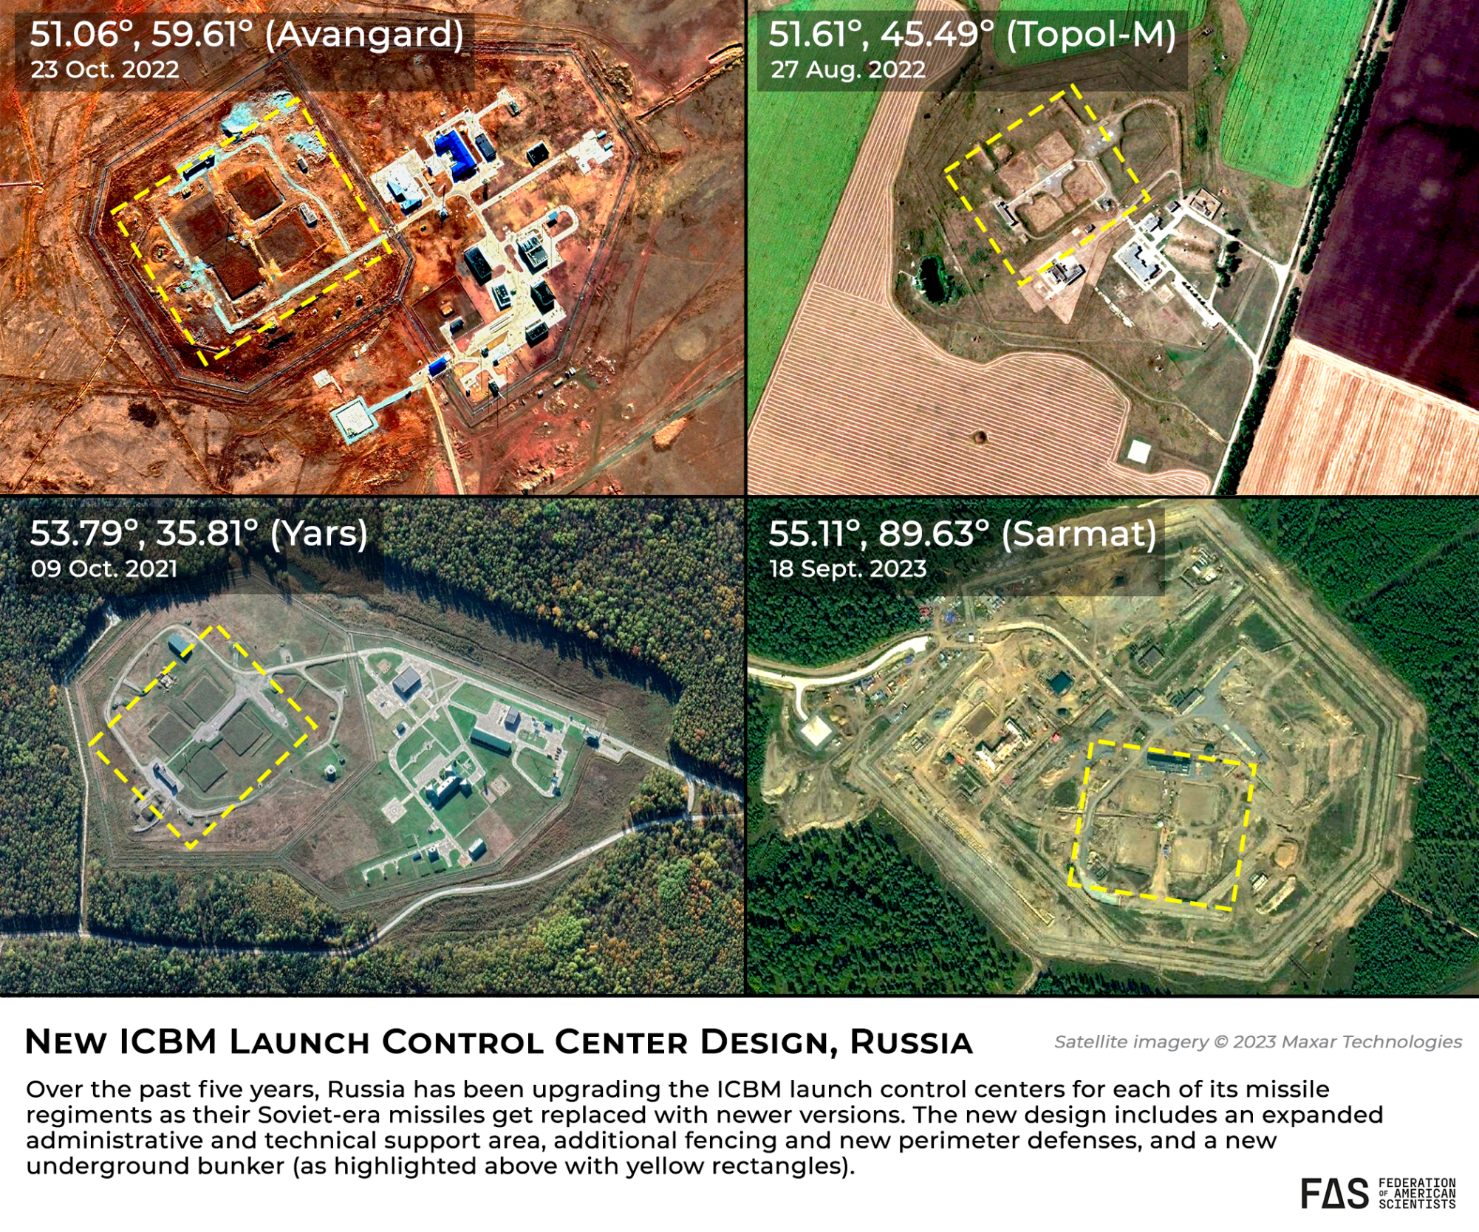

Slide 55
Ground-based forces
Strategic (ICBMs)
Silo
RS-20V Voevoda (SS-18 M6 Satan) RS-28 Sarmat (SS-29)
RS-12M2 Topol-M (SS-27 Mod 1) RS-24 Yars (SS-27 Mod 2)
Avangard (SS-19 Mod 4)
Mobile
RS-12M1 Topol-M (SS-27 Mod 1)
RS-24 Yars (SS-27 Mod 2)
Potential Future
9M730 Burevestnik (SSC-X-9 Skyfall)
Two new ICBM programs

Slide 56
Ground-based forces
Strategic (ICBMs)
Silo
RS-20V Voevoda (SS-18 M6 Satan) RS-28 Sarmat (SS-29)
RS-12M2 Topol-M (SS-27 Mod 1) RS-24 Yars (SS-27 Mod 2)
Avangard (SS-19 Mod 4)
Mobile
RS-12M1 Topol-M (SS-27 Mod 1)
RS-24 Yars (SS-27 Mod 2)
Potential Future
9M730 Burevestnik (SSC-X-9 Skyfall)
Two new ICBM programs

Slide 57
Ground-based forces
Nonstrategic
A-135 anti-ballistic missile defense system is being upgraded to the A-235 system, but it is possible this system will not be equipped with nuclear warheads.
No known modernization plans for the dual-capable ground-based nonstrategic systems: 9K720 Iskander (SS-26) and 9M729 (SSC-8).

Slide 58
Sea-based forces
Strategic (SSBNs and SLBMs)
SSBNs
Delta IV (Project 667BRDM Delfin) Borei/A (Project 955 and Project 995A)
Potential Future
“Arktur” or “Arcturus” strategic submarine design concept
Poseidon nuclear-powered, long-range, nuclear-armed torpedo
New specially configured submarines to carry the Poseidon
Project 09852 Belgorod
Project 09851 Khabarovsk
?

Slide 59
Sea-based forces
Strategic (SSBNs and SLBMs)
SSBNs
Delta IV (Project 667BRDM Delfin) Borei/A (Project 955 and Project 995A)
Potential Future
“Arktur” or “Arcturus” strategic submarine design concept
Poseidon nuclear-powered, long-range, nuclear-armed torpedo
New specially configured submarines to carry the Poseidon
Project 09852 Belgorod
Project 09851 Khabarovsk
?

Slide 60
Sea-based forces
Strategic (SSBNs and SLBMs)
SSBNs
Delta IV (Project 667BRDM Delfin) Borei/A (Project 955 and Project 995A)
Potential Future
“Arktur” or “Arcturus” strategic submarine design concept
Poseidon nuclear-powered, long-range, nuclear-armed torpedo
New specially configured submarines to carry the Poseidon
Project 09852 Belgorod
Project 09851 Khabarovsk
?

Slide 62
Sea-based forces
Nonstrategic
Variety of systems…
LACMs, SLCMs, ASW, torpedoes and more
SSGNs:
Yasen-M (Project 885/M)
Sierra (Project 945)
Oscar II (Project 949A)
Akula class (Project 971)
Potential Future
Nuclear variant of Kalibr likely to replace SS-N-21 (Sampson) LACM
Borei-K nuclear-armed cruise missile submarine after 2027

Slide 63
Sea-based forces
Nonstrategic
Variety of systems…
LACMs, SLCMs, ASW, torpedoes and more
SSGNs:
Yasen-M (Project 885/M)
Sierra (Project 945)
Oscar II (Project 949A)
Akula class (Project 971)
Potential Future
Nuclear variant of Kalibr likely to replace SS-N-21 (Sampson) LACM
Borei-K nuclear-armed cruise missile submarine after 2027

Slide 64
Air-based forces
Strategic bombers
Bombers
Tu-160 (Blackjack) Tu-160M/M1/M2 in 2025
Tu-95MS (Bear-H)
ALCMs
AS-15 Kent (Kh-55) AS-23B (Kh-102)
Potential Future
Reported “Novel” Kh-BD cruise missiles
PAK DA next generation stealth bomber under development

Slide 65
Air-based forces
Strategic bombers
Bombers
Tu-160 (Blackjack) Tu-160M/M1/M2 in 2025
Tu-95MS (Bear-H)
ALCMs
AS-15 Kent (Kh-55) AS-23B (Kh-102)
Potential Future
Reported “Novel” Kh-BD cruise missiles
PAK DA next generation stealth bomber under development

Slide 66
Air-based forces
Strategic bombers
Bombers
Tu-160 (Blackjack) Tu-160M/M1/M2 in 2025
Tu-95MS (Bear-H)
ALCMs
AS-15 Kent (Kh-55) AS-23B (Kh-102)
Potential Future
Reported “Novel” Kh-BD cruise missiles
PAK DA next generation stealth bomber under development

Slide 67
Air-based forces
Nonstrategic
Bombers
Tu-22M3 (Backfire) Tu-22M3M
Su-24M (Fencer-D) New Su-34 (Fullback)
MiG-31K
New Su-57 (PAK FA)
Air-launched missiles
Kh-22 (AS-4 Kitchen) Kh-32
New 9-A-7760 Kinzhal (Dagger)
Potential Future
Kh-95 hypersonic ballistic missile

Slide 68
In the context of Russia’s war in Ukraine
Goal of Russia’s nuclear modernization programs:
Replace aging Soviet-era systems
Parity with the United States
Compensate for conventional inferiority
Threat of US missile defense systems
Compensate for conventional losses during the war
Deter US and NATO from intervening with military forces in the war

Slide 69
PONI Winter Conference
Nuclear Lessons Learned From the Ukraine Conflict
February 26, 2024
Learn more about the Project on Nuclear Issues at the
Next Generation Nuclear Network
nuclearnetwork.csis.org

Slide 70
Russian Strategic Deterrence:
Unpacking Misconceptions
Caroline Russell
Georgetown University Walsh School of Foreign Service
M.A. Candidate German and European Studies 2024

Slide 71
732
Days since Russia launched it’s War in Ukraine
Notes:
According to report - 204 nuclear remarks,

Slide 72
RESEARCH QUESTION
What is the connection between Russian strategic deterrence and escalation management, and how does it differ from the commonly used phrase “escalate to de-escalate”?
This presentation addresses misconceptions surrounding the phrase “escalate to de-escalate” and provides an overview of Russian strategic deterrence,

Slide 73
Conventional Wisdom is Flawed
Escalate to De-Escalate: a supposedly new Russian plan to use limited nuclear strikes in a local/regional conflict, the belief being that such an escalation from conventional to nuclear conflict would shock an adversary into suing for peace.
Notes:
For example, the 2014 annexation of Russia displayed Russia’s ability to operate at a low level of conflict and avoid NATO intervention.
https://www.russiamatters.org/analysis/escalate-deescalate-part-russias-nuclear-toolbox
https://thebulletin.org/2024/02/escalating-to-de-escalate-with-nuclear-weapons-research-shows-its-a-particularly-bad-idea/?utm_source=AM+Nukes+Roundup&utm_campaign=d6e8449b38-EMAIL_CAMPAIGN_2018_07_25_12_19_COPY_01&utm_medium=email&utm_term=0_547ee518ec-d6e8449b38-391895502

Slide 74
The term “escalate to de-escalate” is too commonly used as a buzzword with many misconceptions of its true definition.
Dismisses the notion that Russia has a plan and capacity to use calculated escalation to terminate a conflict.
Overlooks other actions taken intentionally below escalation thresholds
Notes:
For example, the 2014 annexation of Russia displayed Russia’s ability to operate at a low level of conflict and avoid NATO intervention.

Slide 75
OVERVIEW
INTRODUCTION
Strategic Deterrence
RESEARCH DESIGN
Key Terms
TAKEAWAYS
Holistic Strategy
RECOMMENDATIONS
Informing Policy

Slide 76
01
INTRODUCTION
Why is this research important?

Slide 77
INTRODUCTION
Russia’s Strategic Deterrence
Russia’s strategic deterrence rests on levels of deterrence with non-nuclear and nuclear weapons
Understanding the distinction between Russian and Western strategic thinking is imperative.
Russians view escalation management as a vital form of military strategy, while Western doctrine often overlooks escalation management
стратегическое сдерживание
(strategicheskoe sderzhivanie)
Notes:
including the Russian word for deterrence which also means containment\ (people love to show off that they know this)

Slide 78
02
RESEARCH DESIGN
Setting up the Research

Slide 79
Understanding the Model
Notes:
Reference my sources here - used the bulk of michael kofman’s work with referencing russian military doctrines, think tank analysis and recent headlining
Discuss methodology here

Slide 80
KEY TERMS
Strategic Deterrence: “A series of interrelated political, military, military-technical, diplomatic, economic, and informational measures aimed at preventing the use of force against Russia.”
Escalation Management: A tool to “deter direct aggression, preclude a conflict from expanding, prevent or preempt the use of highly damaging capabilities against the Russian homeland that could threaten Moscow’s sovereignty.”

Slide 81
03
TAKEAWAYS: UNPACKING WESTERN MISCONCEPTIONS
Russia’s Grand Strategy of Deterrence

Slide 82
A Holistic Strategy
01
Military and Non-Military
02
Higher Risk – Lower Threshold
Political Military Military-Technical Diplomatic Economic Informational
Notes:
Previous Russian military doctrine regarded the use of these nuclear weapons as limited in scope.
Military (conventional) and non-military means
Variety of sources, CNA , oscar jonsson,
Nonviolent means of information warfare and traditional war-fighting go hand in hand to manage conflicts.
Higher acceptance of risk and a lower threshold for the use of force

Slide 83
Strategic Deterrence
Strategic Deterrence
Nuclear
Non-Nuclear
Global
Regional
strategic conventional
weapons
strategic defensive
systems
CONTAIN AN ADVERSARY IN PEACETIME
Notes:
Strategic deterrence used to contain the adversary during peacetime, and in wartime used for the goal of escalation management
and oftentimes, they view the local employment of precision weapons without nuclear weapons at the beginning stages of conflict to potentially prevent or delay the usage of nuclear weapon
strategic defensive
systems such as integrated air and missile defense, and other capabilities that could shock and
disorganize an opponent.

Slide 84
Nuclear Deterrence
Global Deterrence |  | Regional Deterrence
“The threat of use of conventional, and if needed, nuclear weapons, primarily in any regional wars initiated against Russia and its allies.” |  | “Threat of mass strategic conventional and strategic nuclear weapons, the damage from which would be greater than the advantage that the aggressor expects to receive as a result of using military force.”
Notes:
In Russian thinking, strategic
deterrence represents both a state's theory of how to attain security in peacetime, and an
inclusive national security concept to coordinate the various means at its disposal to manage
escalation.
. The concept is adaptable: it can apply to managing contingencies ranging from local
wars with a single state, to regional conflicts against coalitions, to large-scale wars against
nuclear-armed global powers such as the United States. Table 1 provides a reference on how
the Russian military conceives of conflict phases

Slide 85
Key Takeaways in Context with the War in Ukraine
Russian Military Strategy
Grand strategy; not solely opportunistic
Escalation Dynamics
“Tailored escalation”
Nuclear and Non-Nuclear
On the Global and Regional Levels
Notes:
Therefore, escalation management is best used when damaging the adversary enough to make them realize that any benefit a war would have provided for them is going to be overshadowed by the costs inflicted on them if they pursue this war.
Apply these takeaways to Ukraine and how the distinction between these three is crucial

Slide 86
04
RECOMMENDATIONS
Using this analysis to form policy.

Slide 87
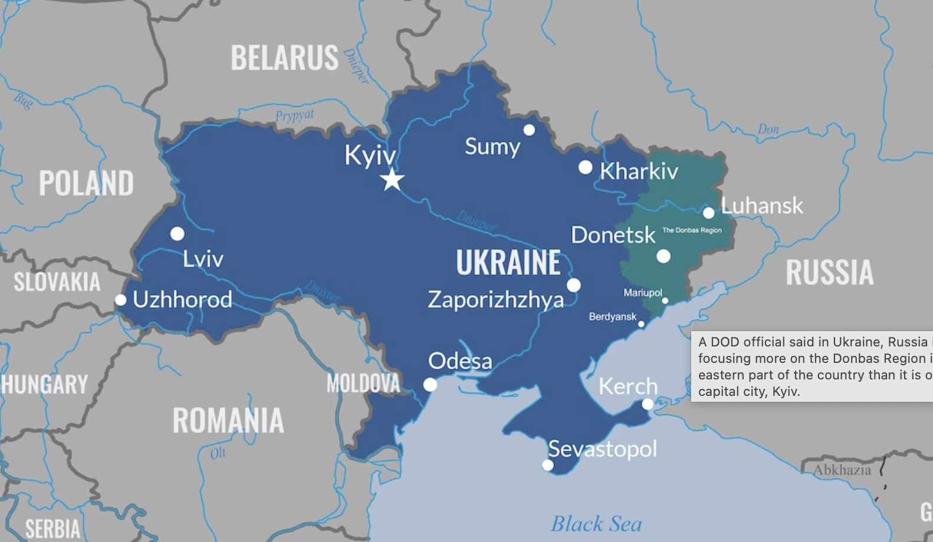
RECOMMENDATIONS
ALLIES
01
Convene with NATO allies to strengthen response against any threat of escalation
02
ANALYSIS & COMMUNICATION
Track 1 and Track 2 dialogues with experts on Russian Strategic Deterrence
03
INTERAGENCY
Interagency briefings between DoE, DoD, and DoS
Notes:
Reference recent displays of nuclear escalation, and what to understand in the current context
Reference these two examples of putin’s discourse as examples of nonmilitary means of deterrence- all levels of war
Strategic deterrence will continue to be a focal point of Russia’s military strategy in the future; as new systems, such as the Poseidon (intercontinental nuclear-powered nuclear torpedo) and the Burevesnik (intercontinental nuclear-powered nuclear cruise missile) evolve, Russia will utilize these non-strategic nuclear weapons in escalation management
"Russia will utilize these non-strategic nuclear weapons to *strengthen/complicate/ etc) escalation management

Slide 88
THANK YOU PONI TEAM AND CSIS
QUESTIONS?

Slide 89
Risks in the Current Geopolitical Context
THREAT OF NUCLEAR ESCALATION IS INCREASING DUE TO UKRAINE WAR
90 Seconds to Midnight
Notes:
So what slide - why is this research important? Because nuclear risk poses a threat to us all
Relate to ukraine conflict
Russia has been ultimately relying on lower-level actions that use escalation management to deter the U.S. and prevent any threat of external intervention in these conflicts. This is specifically alarming because it provides Russia with more flexibility below the nuclear threshold to manage escalation and wage conflicts.

Slide 90
Returning at 2:45 PM (EST)
Receiving the Message: Russian Nuclear Signaling & Risk Perceptions
Moderator: Dr. Andrew Reddie – Associate Research Professor, University of California, Berkeley
Panelists:
Sophia Anastazievsky– Ph.D. Candidate, Department of Philosophy, University of California, Irvine
Kiley McCormick– Federal Contractor
Kaitlin Peach – Ph.D. Candidate and Graduate Research Assistant, Institute for Public Policy Research and Analysis, University of Oklahoma

Slide 91
What We Owe to Ukrainians: A Moral Perspective on Nuclear Coercion and Military Intervention
Sophia Anastazievsky
PhD Student, Philosophy, University of California, Irvine
(Ethics of War)
sanastaz@uci.edu

Slide 92
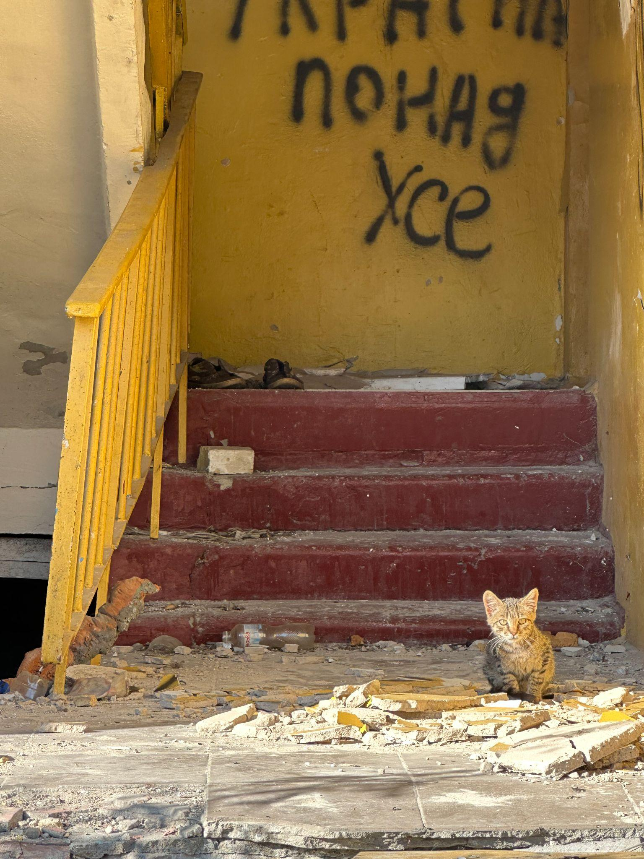
Notes:
A cat amongst the ruins of a destroyed apartment building in Borodyanka

Slide 93
Roadmap
Introduce ethical framework
Apply ethical framework to war in Ukraine
Discussion of nuclear coercion and risk in this context
Suggestion: nuclear risk is not obviously higher if we succumb to nuclear coercion
Possible courses of action
Conclusion
Notes:
This presentation will follow the following structure. First, I will introduce the ethical framework that guides my reasoning and argumentation. Then, I will show how this framework applies to the war in Ukraine, and discuss nuclear coercion and nuclear risk in this context.
Following this background discussion, I will point out some issues with prevalent arguments in expert reasoning and suggest some additional relevant considerations.
Finally, I will make some suggestions for courses of action that might mitigate nuclear risk while still allowing us to fulfill our moral obligations to Ukrainians.

Slide 94
Key Arguments:
Background: Using an ethical framework to assess conduct with respect to war
Elements of the framework
Moral duty to ensure Ukraine’s military victory
Humanitarian reasons; security reasons
Role of nuclear risk in determining the most just course of action
Takeaway: There is a moral imperative to ensure Ukraine’s victory. It is critical to assess the actual nuclear risks involved in both military intervention and non-intervention alongside the moral risks of allowing Russia to succeed.
Notes:
In this presentation, I will make and defend two claims:
First, that there is a strong duty on the part of the international community to ensure that Ukraine achieves a military victory in its current war against Russian aggression and full territorial integrity.
Second, that the most relevant consideration with respect to the extent and nature of International assistance concerns Russian nuclear coercion, and furthermore, that it is not obvious that nuclear war risks are lower if Western nations comply with Russian nuclear coercion.

Slide 95
Ethics of War
Jus ad bellum criteria:
Just Cause
Right Intent
Right Authority
Last Resort
Chance of Success
Proportionality
Why use this framework?
Notes:
Just cause: the reason for going to war is justified. This is often considered to be limited to defense against aggression and humanitarian intervention.
Right intent: Is a war being fought with the correct objectives? I.e. to restore legitimate sovereignty, or to stop an atrocity.
Right authority: do the parties to the conflict have the appropriate jurisdiction to prosecute a war? In the case of humanitarian intervention, any party has the right authority
Last resort: have all plausible non violent options been pursued?
Chance of success: is there a reasonable chance of victory? Note that this does not mean that victory is ensured, or even overwhelmingly likely. This criterion does not always apply in cases of defense against aggression, according to some theorists
Proportionality: Jus ad bellum proportionality considers the harms a war inflicts against those it prevents
Why use this framework?
The main advantage of this framework is that it balances and incorporates both normative considerations and practical considerations. There are always moral assumptions baked into our decisions, and this framework has the advantage of making that explicit. It also aligns better with our objectives of promoting a just and rules based global order, ultimately enabling us to arrive at the course of action which is both morally justifiable and likely to be successful.

Slide 96
Jus ad bellum and Ukraine
Right to intervene:
Illegitimate sovereignty in temporarily occupied territories of Ukraine
Prevalence and scale of human rights violations
Assessing each criterion:
All are clearly met, with the exception of proportionality
Proportionality determination involves weighing risk of nuclear war against moral risks of non-intervention

Slide 97
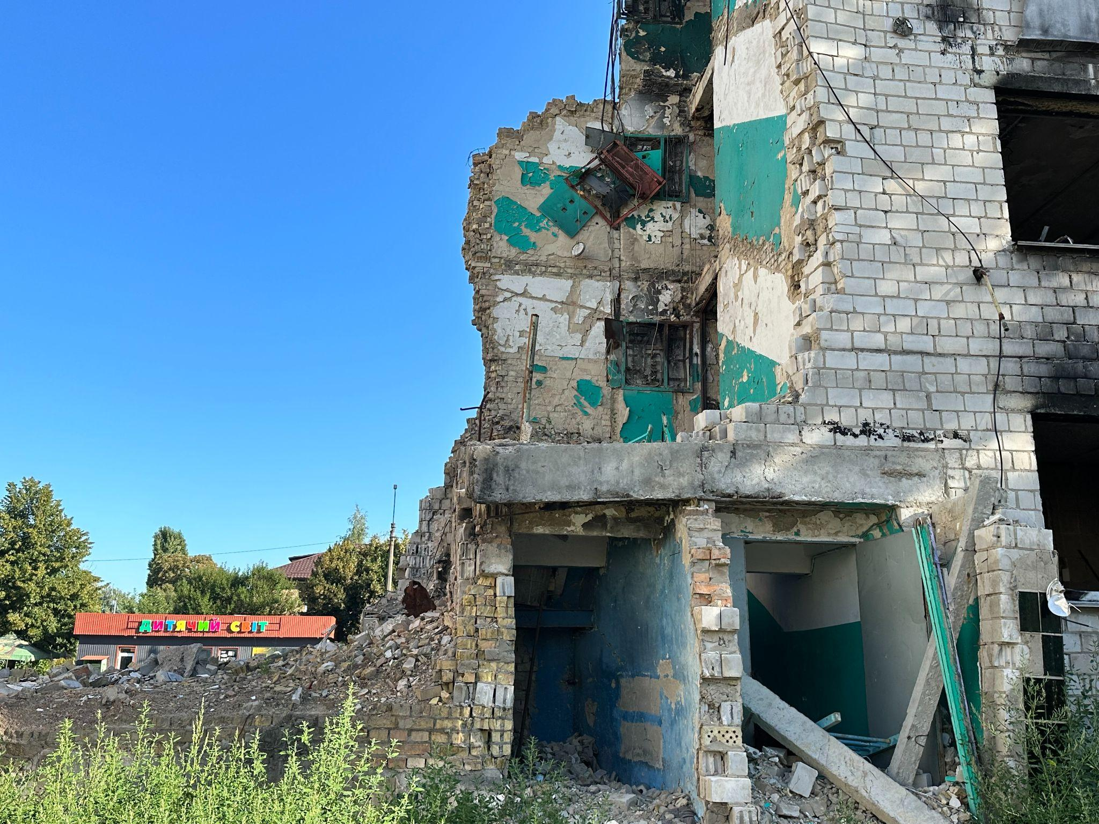
Notes:
Site of a Russian strike directly in front of a children’s daycare center in Borodyanka

Slide 98
Rights Violations (partial list)
Indiscriminate attacks on civilians/ execution of civilians (e.g. Bucha, Irpin, etc.)
Arbitrary detention and torture of civilians and planned expansion of prison camps
Forced deportation of Ukrainian children (numbers may be in the hundreds of thousands)
Rape as a military tactic, including of children
Destruction of Mariupol, with death toll possibly running more than thrice early estimates of 25,000 killed (Associated Press)
Intent to destroy Ukrainian identity

Slide 99
Moral Obligation to Ensure Ukrainian Victory
Duty of Rescue
Reliance Duties
Upholding International Legal Norms
Duties to own citizens
Duties to the international community
Notes:
Security threat to own citizens,

Slide 100
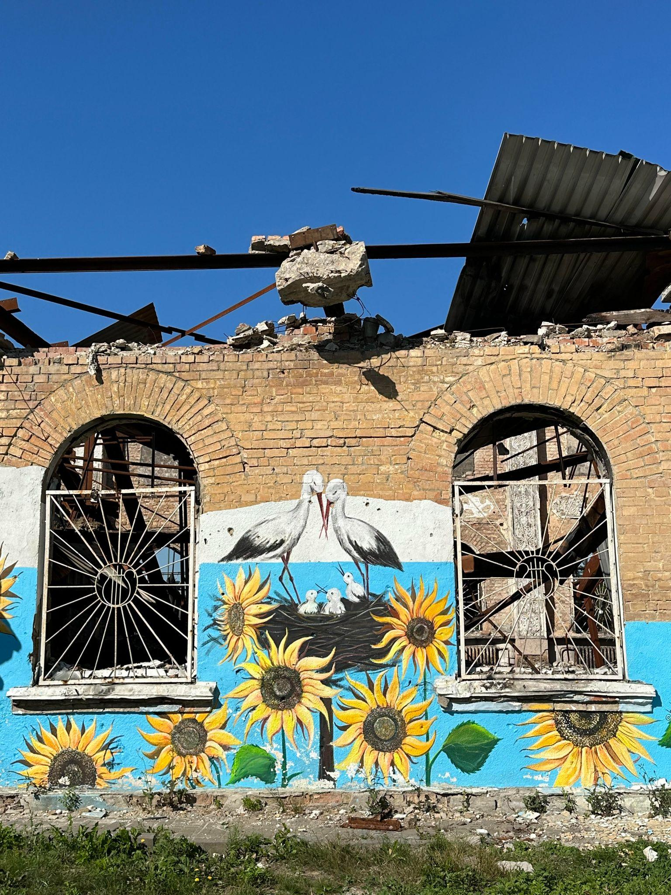
Notes:
Graffiti on a destroyed community center in Irpin

Slide 101
Proportionality and Nuclear Risk
Key mistake made by experts:
Assuming that the nuclear risks involved in resisting Russian nuclear coercion are higher than those involved in succumbing to it.
Some make the extreme assumption that challenging these threats will lead to nuclear armageddon.
Failure to consider the risks of succumbing to nuclear coercion.

Slide 102
Possible Risks of Succumbing to Nuclear Coercion
Signalling that nuclear coercion is an effective tactic will encourage other nuclear states to use this approach in future disputes.
Increase in nuclear threats
Increase in aggressive behavior by nuclear states
Signalling to non-nuclear states that their territorial integrity and interests will not be protected by nuclear armed allies
Incentivizing nuclear proliferation

Slide 103
Possible Solutions (Suggestions) and Relevant Considerations
Multi-pronged approach:
Information campaigns against Russia
Strategic elimination of military targets
Conventional deterrence
Deployment of nuclear weapons to Europe
Investment in technology
A successful international response to Russian aggression and nuclear coercion will create the conditions for genuine democracy in Russia, deter Russian nuclear threats, and restore Ukrainian territorial integrity.

Slide 104
Conclusion
The moral risks of non-intervention are clear:
Weakening of international laws/norms
Setting a precedent for future nuclear coercion
Failure to prevent extreme and prevalent human rights abuses, including what experts have described as genocide
Before we allow Russian nuclear coercion to prevent the international community from fulfilling our duties to help Ukrainians, the real risks of nuclear war need to be assessed, especially the risk of doing nothing. The most prudent course of action may well be the most moral one.

Slide 105
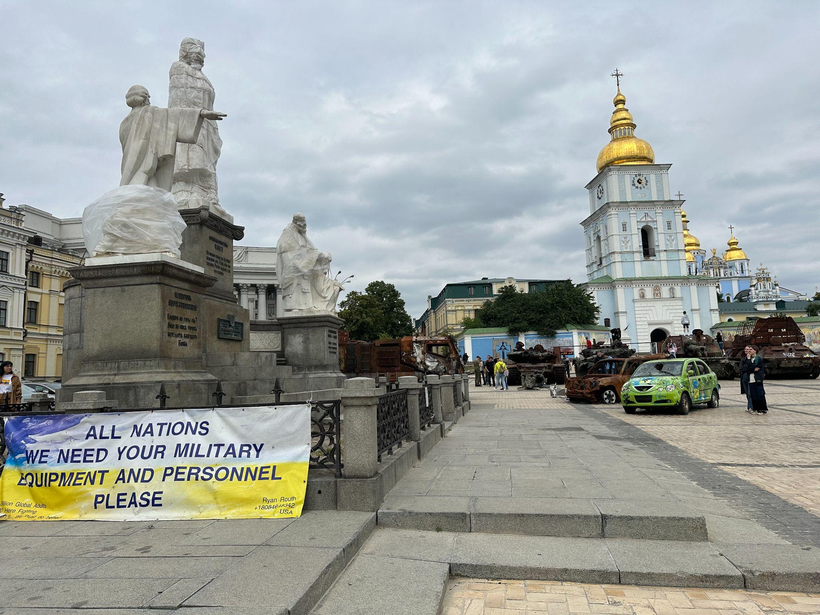
Notes:
Destroyed Russian military equipment on a plaza in the center of Kyiv. Note the plastic covering the statues in order to minimize damage to cultural heritage in event of Russian attacks.

Slide 106
Thank You!
sanastaz@uci.edu

Slide 107
PONI Winter Conference
Nuclear Lessons Learned From the Ukraine Conflict
February 26, 2024
Learn more about the Project on Nuclear Issues at the
Next Generation Nuclear Network
nuclearnetwork.csis.org

Slide 108
US Public Perceptions of Nuclear Weapons Use in the Russia-Ukraine War
Kaitlin Peach
PhD Candidate/Graduate Research Assistant
Institute for Public Policy Research and Analysis, University of Oklahoma
katiepeach@ou.edu
Co-authors:
Andrew Fox, Kuhika Gupta,
Joseph Ripberger, Cheyenne Black,
Tristan Winkle, and Hank Jenkins-Smith

Slide 109
BLUF
Research Questions:
(1) How does the US public feel the US should respond if Russia were to use nuclear weapons in Ukraine?
(2) Does the US public rely on practical, ethical, or normative values when making these decisions?
(3) How do normative, ethical, and practical understandings of nuclear weapons use and non-use fair under this scenario?
Results:
Our findings demonstrate that the US public, even in the context of a real-world conflict and increased nuclear threats from Russia, is reluctant to opt for a US nuclear response and, instead, is far more supportive of a conventional response.
Using qualitative data, we examine the reasoning behind respondents’ policy preferences and find that regardless of the policy option, respondents primarily follow the logic of consequences (military utility, strategic interaction).
The qualitative results indicate that the public’s policy choices are context dependent. Despite support for a conventional response, the public does express willingness to escalate to a nuclear response.
Policy Implications: Public may be supportive of increased spending on conventional or conventional-nuclear integration (CNI)

Slide 110
Presentation Outline
Theoretical and Policy Background
Overview of the survey questions and data
Results
Implications and Conclusion
What do our results mean for theory and practice?

Slide 111
Background
Theoretical Background
Public opinion matters during a nuclear crisis (Allison et al., 2022)
Literature on public opinion on nuclear weapons use demonstrates a weak nuclear taboo (ex: Press et al., 2013; Sagan & Valentino, 2017; Haworth et al., 2019)
Our study diverges by including a non-NATO/non-treaty ally in the scenario
In our scenario, the taboo has already eroded because Russia attempted to use/used a nuclear weapon
Policy Background
Public opinion imposes audience costs on policymaker decisions (Fearon, 1994)
Europeans have expressed more support for nuclear weapons (Onderco et al., 2023) and Russians prefer conventional victory over a nuclear strike (Smetana and Onderco, 2023)
Ongoing policy debate: Is conventional enough for deterrence? Do we focus on CNI?

Slide 112
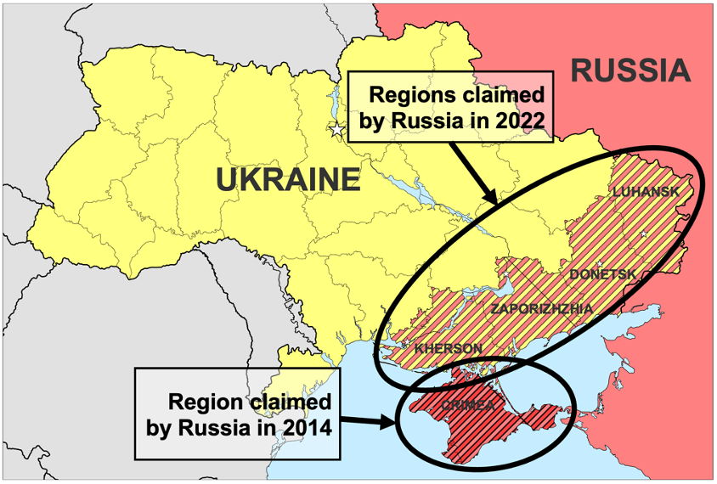
Data & Methods
Data
2022 Institute for Public Policy Research and Analysis National Security Survey
N = 2,038 US adults
Fielded: December 15-19, 2022
Survey experiment with three treatment groups
Methods
T-tests
Qualitative Response Coding
Coded for logic of appropriateness and logic of consequences
Map shown in survey experiment

Slide 113
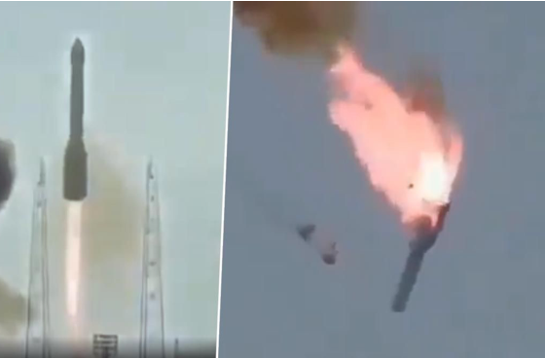
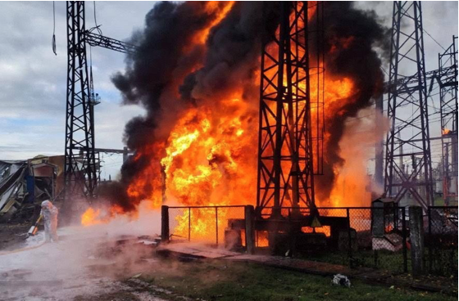
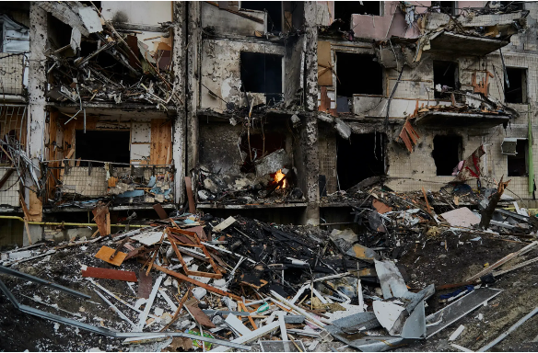
Survey Experiment
Failed attempt: Ten days later, U.S.
intelligence officials confirm that Russia attempted to deploy a nuclear weapon in Ukraine, but the deployment failed for technical reasons. Following the failure, Putin announces his intention to try again.
Military target: Ten days later, U.S. intelligence officials confirm that Russia deployed a tactical nuclear weapon in Ukraine. The weapon targeted Ukrainian military forces and infrastructure, but early investigations indicate that it killed approximately 500 Ukrainian civilians and injured many others.
Civilian target: Ten days later, U.S. intelligence officials confirm that Russia deployed a strategic nuclear weapon in Ukraine. The weapon targeted Ukrainian civilians and early investigations indicate that it killed approximately 10,000 Ukrainian civilians and injured countless others.

Slide 114
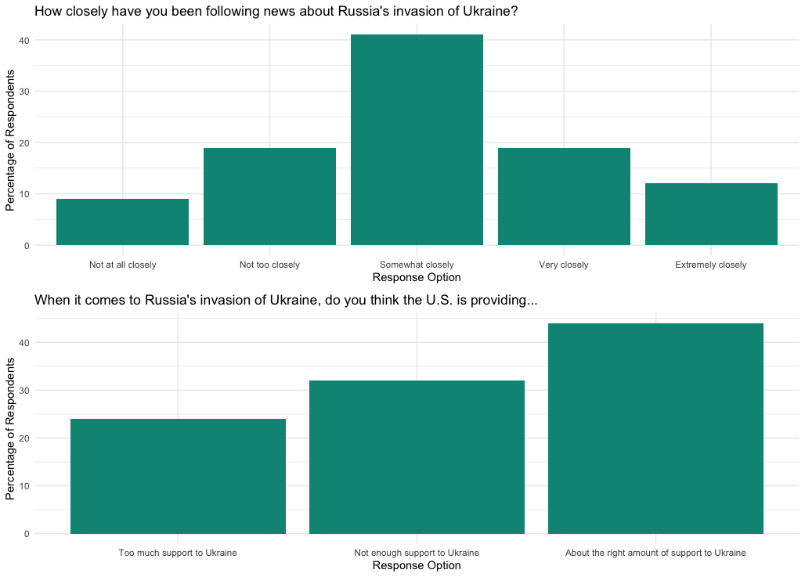
Results: Pre-Treatment Questions

Slide 115
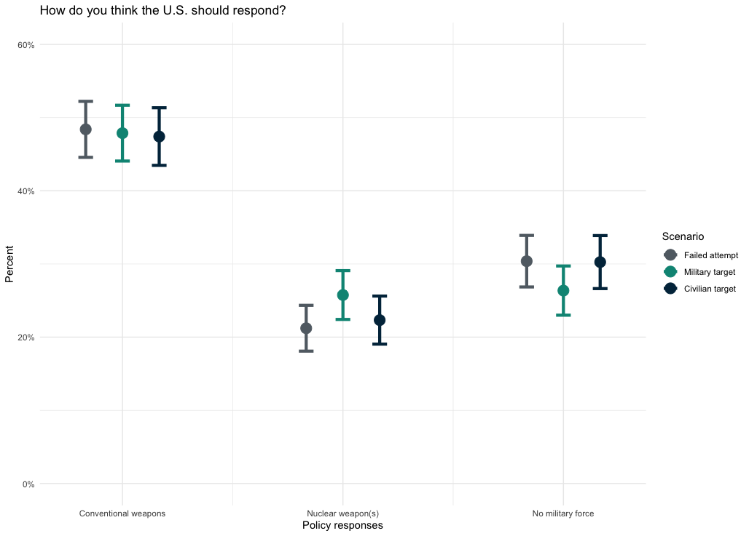
Results: Post-Treatment Questions

Slide 116
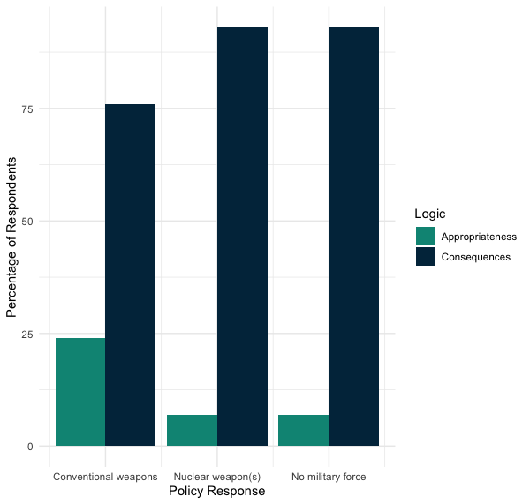
Results: How are policy preferences shaped?

Slide 117
Implications/Conclusion
Theory:
Our results support previous studies’ findings of a weak nuclear taboo and policy preferences influenced by the logic of consequences (military utility and strategic interaction)
Policy:
The US public is supportive of a conventional response to a Russian nuclear strike
The public expresses a willingness to escalate if a conventional response fails to deter Russia
Implications: potential public support for increased spending on conventional improvements and/or CNI
Future Directions
Average treatment effect of scenarios
Study support for conventional deterrence and CNI more broadly
Notes:
-public opinion matters-audience costs (look at Allison article)

Slide 118
Contact Us!
Presenting Author: Kaitlin Peach, PhD Candidate/Graduate Research Assistant at the Institute for Public Policy Research and Analysis, katiepeach@ou.edu
Co-Author Team: Andrew Fox, Kuhika Gupta, Joseph Ripberger, Cheyenne Black, Tristan Winkle, Hank Jenkins-Smith
ou.edu/ippra

Slide 119
Backup Slides

Slide 120
References
Allison, David M., Stephen Herzog, and Jiyoung Ko. 2022. “Under the Umbrella: Nuclear Crises, Extended Deterrence, and Public Opinion.” Journal of Conflict Resolution 66(10): 1766–96.
Fearon, James D. 1994. “Domestic Political Audiences and the Escalation of International Disputes.” The American Political Science Review 88(3): 577–92. doi:10.2307/2944796.
Haworth, Alida R., Scott D. Sagan, and Benjamin A. Valentino. 2019. “What Do Americans Really Think about Conflict with Nuclear North Korea? The Answer Is Both Reassuring and Disturbing.” Bulletin of the Atomic Scientists 75(4): 179–86.
Onderco, Michal, Michal Smetana, and Tom W. Etienne. “Hawks in the Making? European Public Views on Nuclear Weapons Post-Ukraine.” Global Policy n/a(n/a). https://onlinelibrary.wiley.com/doi/abs/10.1111/1758-5899.13179 (May 11, 2023).
Press, Daryl G., Scott D. Sagan, and Benjamin A. Valentino. 2013. “Atomic Aversion: Experimental Evidence on Taboos, Traditions, and the Non-Use of Nuclear Weapons.” American Political Science Review 107(1): 188–206.
Sagan, Scott D., and Benjamin A. Valentino. 2017. “Revisiting Hiroshima in Iran: What Americans Really Think about Using Nuclear Weapons and Killing Noncombatants.” International Security 42(1): 41–79.
Smetana, Michal, and Michal Onderco. 2022. “Elite-Public Gaps in Attitudes to Nuclear Weapons: New Evidence from a Survey of German Citizens and Parliamentarians.” International Studies Quarterly 66(2): sqac017.

Slide 121
Survey
Demographic Questions
Other Nuclear Weapons/National Security Questions
Pre-Treatment Russia/Ukraine Questions:
Now we have a few questions about Russia’s invasion of Ukraine, which began in February 2022.
How closely have you been following news about Russia’s invasion of Ukraine?
Not at all closely to Extremely closely (1-5 Scale)
When it comes to Russia’s invasion of Ukraine, do you think the U.S. is providing...
1 - Too much support to Ukraine
2 - Not enough support to Ukraine
3 - About the right amount of support to Ukraine

Slide 122
Survey Experiment
The following fictional story describes a military crisis in Ukraine. Please read this story carefully, as you will be asked some questions about it later. Although the events in the story are not real, please do your best to imagine how you would feel about these events if they were to happen in the real world.
BACKGROUND: In September 2022, Russia unilaterally claimed areas in and around four Ukrainian regions: Luhansk, Donetsk, Zaporizhzhia and Kherson. Imagine it is now May 2023, and Ukraine has launched a highly successful counteroffensive against Russian troops inside these regions. Many Russian troops are killed and those who remain are forced to retreat. In a desperate attempt to maintain control, Vladimir Putin announces that he will use nuclear weapons to defend Russian claimed territory if Ukraine does not withdraw. Ukrainian troops refuse.

Slide 123
Post-Treatment Questions
RESPONSE OPTIONS: For the first time in decades, U.S. military officials are considering the use of nuclear weapons in response to Russia’s actions. Experts have contrasting opinions: [randomize; track ordering]
· [Some] argue that the U.S. should respond with at least one small nuclear weapon to send a clear signal to Russia and the rest of the world that the use of nuclear weapons is unacceptable and will always be met with a nuclear response.
· [Others] argue that the U.S. should respond only with conventional weapons because they are as effective as nuclear weapons on the battlefield and limit the possibility of nuclear escalation.
How do you think the U.S. should respond? [randomize first two; track ordering; leave space before option three]
1 - The U.S. should only use conventional weapons in response to Russia’s actions.
2 - The U.S. should use at least one small nuclear weapon in response to Russia’s actions.
3 - The U.S. should not use any military force in response to Russia’s actions.
Can you explain why you think the U.S. should [respondent’s selection] in this situation?
Russia has not used a nuclear weapon in Ukraine, but some people believe the story we describe in this survey seems realistic, possible, and easy to imagine. Others believe it is unrealistic, impossible, and difficult to imagine.
In your opinion, is the story...
1 - realistic, possible, and easy to imagine; 2 - unrealistic, impossible, and difficult to imagine

Slide 124
Qualitative Data Examples
Scenario Option - Coding | Quote
Conventional Weapons - Appropriateness | Because we cannot debase ourselves and cause that kind of destruction and maintain our integrity and philosophy against nuclear war
Conventional Weapons - Consequences | Using a nuclear weapon can make Russia justified to use it too, and conventional weapons do less destruction.
No Weapons - Appropriateness | World peace is what we need. Not violence
No Weapons - Consequences | if some military force is used, Russia might retaliate and use it here in USA.
Nuclear Weapons - Appropriateness | In order to protect the innocent people.
Nuclear Weapons - Consequences | to prove that we and the Ukrainians mean business and will retaliate with similar tactics

Slide 125
Thank you for attending!
PONI Winter Conference
Nuclear Lessons Learned From the Ukraine Conflict
February 26, 2024
Learn more about the Project on Nuclear Issues at the
Next Generation Nuclear Network
nuclearnetwork.csis.org

