Slide 1
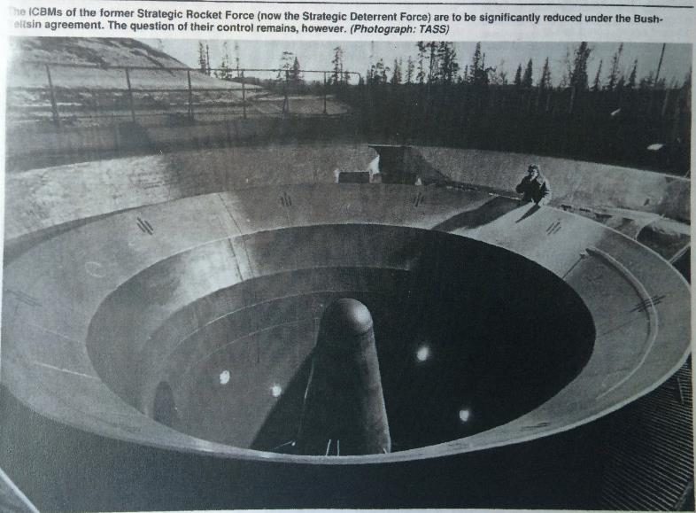
The Power of the NPT: International Norms and Nuclear Disarmament of Ukraine (1990-1994) Mariana Budjeryn HKS Belfer Center
PONI 2016 Winter Conference
Center for Strategic and International Studies
December 6-7, 2016
Washington, D.C

Slide 2
Issue at Stake and Research Question
World-wide nuclear abstinence and the NPT: what is the relationship?
Existing literature is contradictory:
NPT is unimportant (Realists)
NPT provides some benefits to states (Regime theorists)
NPT one of the factors in nuclear-decision making (Domestic politics)
NPT constrains supply-side of proliferation (Nonproliferation studies)
NPT works through persuasion and social interaction (Constructivists)
What is the role of the NPT in decisions of nuclear renunciation?
How does the NPT affect the demand-side of proliferation?

Slide 3
Cases and Method
Ukraine, Belarus, and Kazakhstan (1990-1994)
“Born nuclear:” supply preceded demand
Expected to denuclearize and join the NPT as NNWS
Follow divergent paths, why?
Security, bargaining, coercion explanations (Potter 1995, Miller 1994, Reiss 1995)
Understudied, not considered specifically in relation to the NPT
Concept development and in-depth comparative case study
Normative mechanisms
Untapped archival sources from Ukraine, Belarus, and Kazakhstan

Slide 4
Nonproliferation Challenges of Soviet Dissolution
1) Physical security: ‘loose nukes’ and ‘brain drain’
2) Proliferation vs state succession
Ukraine, Kazakhstan, and Belarus claim to be successors of the USSR
Whose NW in non-Russian Soviet successor states?
What claims could the non-Russian republics make in regards to nuclear inheritance?
Who would carry out Soviet arms control commitments: START, CFE, NPT?

Slide 5
Nuclear Inheritance of Non-Russian Successor States
Weapons Systems
ICBMs
Strategic bombers
Tactical NW
Other
Belarus
54 SS-25 mobile
< 1,000
Research and experimental reactor HEU
Kazakhstan
104 SS-18 (MIRVed with 10 wh each) Total 1,040 wh
40 TU-95MS 370 AS-15 ALCMs
Semipalatinsk NTS Uranium mining 2 research reactors Nuclear fuel fabrication HEU
Ukraine
176 130 SS-19 (MIRVed with 6 wh each 46 SS-24 (MIRVed with 10 wh each) Total 1,240 wh
44 19 TU-160 Blackjack 25 TU-95MS Bear Armed with 588 AS-15 ALCMs
<2,600
ICBM factory ICBM guidance systems Uranium mining 3 research reactors Heavy water plant HEU
Notes:
Russia inherited about 75% of Soviet Union’s nuclear arsenal
However, the nuclear inheritances of the non-Russian successor states were nevertheless staggering.
While non-Russian republics lacked some key elements of a nuclear weapons program, like uranium enrichment or plutonium reprocessing, or warhead production, their technological and scientific capacity was certainly beyond your average nuclear aspirant.

Slide 6
Ukraine: From Renunciation to ‘Ownership’
July 16, 1990, Declaration of Sovereignty
Undertakes “to become, in the future, a permanently neutral state, which does not participate in military alliances and adheres to three non-nuclear principles: not to maintain, produce or acquire nuclear weapons.”
Chernobyl
Separation from Moscow
Attempts to join the NPT as NNWS
August 24, 1991, Declaration of Independence
Subordinated all military units to the Rada (parliament)
Claimed all assets on Ukraine’s territory as its property
Moves to assume partial control over NW on its territory
Notes:
… the problem of course was that some of these units and some of these assets were associated with the former Soviet nuclear weapons complex

Slide 7
Ukraine: Three Visions on Nuclear ‘Ownership’
”Nuclear ownership:” At the time of the dissolution, Ukraine, as a successor state of the Soviet Union, had an equal right to become a nuclear weapons state, a right it chose not to fulfill.
Entitlement to compensation (President and Ministry of Foreign Affairs): financial compensation and security guarantees
Nuclear hedging (national-democrats in the Rada): Ukraine – a de facto and de jure nuclear state, should ratify START but not join NPT, retain 46 SS-24s, use NW for political leverage
Nuclear deterrent (Gen-Maj. Volodymyr Tolubko): in close cooperation with Russia
Notes:
Nuclear deterrent position, the most marginal of the three
Throughout 1993
While the official position of Ukraine with US interlocutors remained nuclear renunciation conditional on guarantees and compensation
Internal debate transpired between the first and second positions.

Slide 8
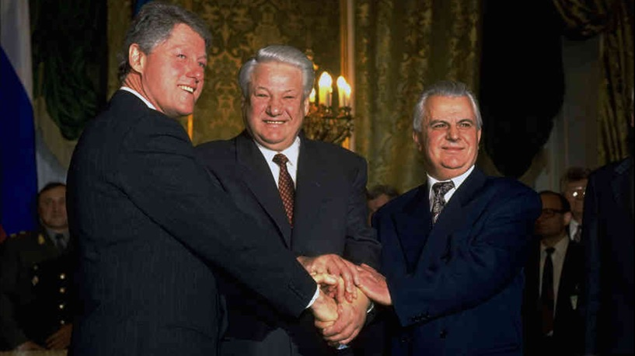
Ukraine: From ’Ownership’ to Renunciation
Ukraine’s inability to legitimate nuclear ‘ownership’ as a new category and join the international community on good terms
Going against nuclear zeitgeist and the way international order works
Clinton administration: combination of negative and positive inducements
Concessions
Security assurances from Russia and US
Compensation for HEU in Ukrainian warheads
Photo credit: Diana Walker/Time
US President Clinton, Russian President Yeltsin and Ukrainian President Kravchuk after signing the Trilateral Statement in Moscow.
January 14, 1994.

Slide 9
Summary of Findings
NPT had salient constitutive effects on post-Soviet denuclearization
Framed the debate on NW in terms of proliferation
US and Russia negotiated with UA,(BL and KZ) within the fold of the NPT
All actors had to grapple with NPT’s categories and terms
Discourses about nuclear weapons are more than just about the weapons
Part of post-Soviet political and security settlement
Embedded in emerging security narratives
Dearth of deterrence/military rationale for keeping NW

Slide 10
Relevance and Policy Implications
NPT at its best – a constitutive part of international order
NPT is not and should not be reducible to US (and other NWS) interests
To maintain NPT legitimacy, US and Russia must be constrained by the regime
Importance of making NPT universal
Legitimizing nuclear states outside of the NPT – bad idea (Israel, India, Pakistan)
Importance of broadening engagement with aspirants beyond the nuclear issue
Russo-Ukrainian conflict
Close US-Russian cooperation on nuclear disarmament; Russia-first policy
International support for Ukraine needed to prevent further damage to NPT regime inflicted by Russian invasion

Slide 11
NPT’s Impact on Nuclear Renunciation of Ukraine
 | Mechanism | Definition
Constitutive | Delineation of normative space | Set of rules for nuclear possession
 | Normative grammar | Categories, definitions, NWS vs NNWS
 | Status in belonging | Identity-, nation-building
Discursive | Normative reasoning | Persuasion, ethical merits of nonproliferation
 | Normative match | Affinity between int’l and domestic anti-nuclear norms
 | Burden of justification | Supports advocates of nonproliferation, necessitates providing reasons for deviation from the norm
 | Legitimation of coercive enforcement | Vs arbitrary application of coercive force

Slide 12
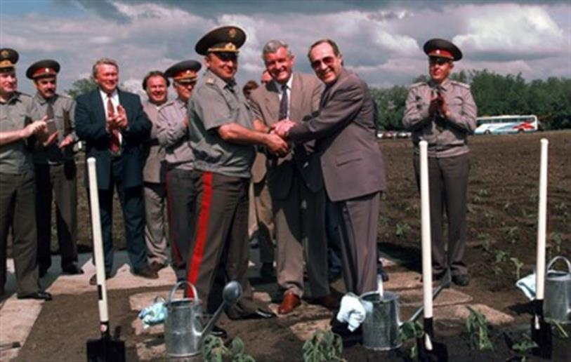
Thank you.
US Secretary of State William Perry, Ukrainian Minister of Defense Valery Shmarov and Russian Minister of Defense Pavel Grachev (right to left) plant sunflowers at the site of ICBM silo in Pervomaisk, Ukraine, 1996

