Slide 1
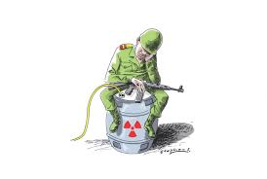
A Paper Tiger or a World Free of Nuclear Terrorism? Law, Politics and Institutional Design of the UN Security Council Resolution 1540.
Presented by: Sarah Shirazyan
SJD, Stanford Law School
CSIS, PONI Capstone Conference
Offutt Air Force Base, Nebraska

Slide 2
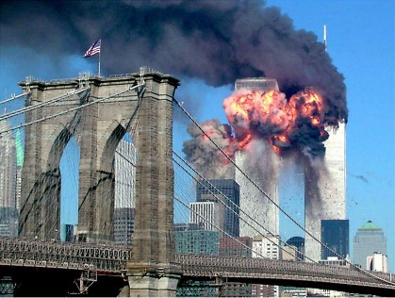
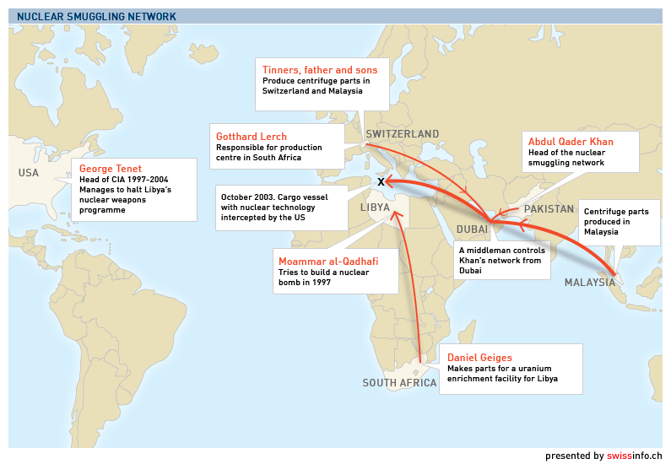
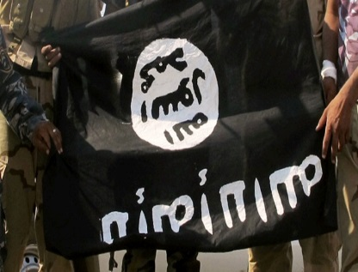
The Threat of Nuclear (Radiological) Terrorism
Atomic jihad: terrorists seek nuclear materials
Black markets in nuclear materials
ISIS ambition to access nuclear materials
Image courtesy: Reuters Sara K. Schwittek; Swissinfo.ch; Russia Today.

Slide 3
UN Security Council Resolution 1540: A Global Counter-Proliferation Instrument
State sponsored WMD terrorism
Secure nuclear materials
domestic measures related to accounting and securing.
refrain from supporting non-state actor proliferation
Criminalize nuclear proliferation
Border & law enforcement
Domestic measures to also combat illicit brokering.
Adopt and enforce criminal laws and regulations
Target illicit trafficking
Export-Import Controls
Monitor WMD production, storage, transport and etc.
Establish and enforce export and trans-shipment controls.
Present National Compliance Report
Image courtesy: United Nations.

Slide 4
1540 Institutional Players and Structure
The institutional architecture that Security Council has established to advance domestic implementation of 1540 obligations embraces various players whose mandates, priorities and relationship with one another have dramatically evolved overtime.
UN Security Council
1540 Committee
UNODA
Disarmament Affairs
DPA
Political Affairs
Group of Experts
Regional Disarmament Offices

Slide 5
Collected Evidence : Embedded Case Study Design
Content Analysis of Documents
Observations
Interviews
Fieldwork
How does 1540 implement its mandate as a global counter-proliferation tool?
Image courtesy: United Nations.

Slide 6
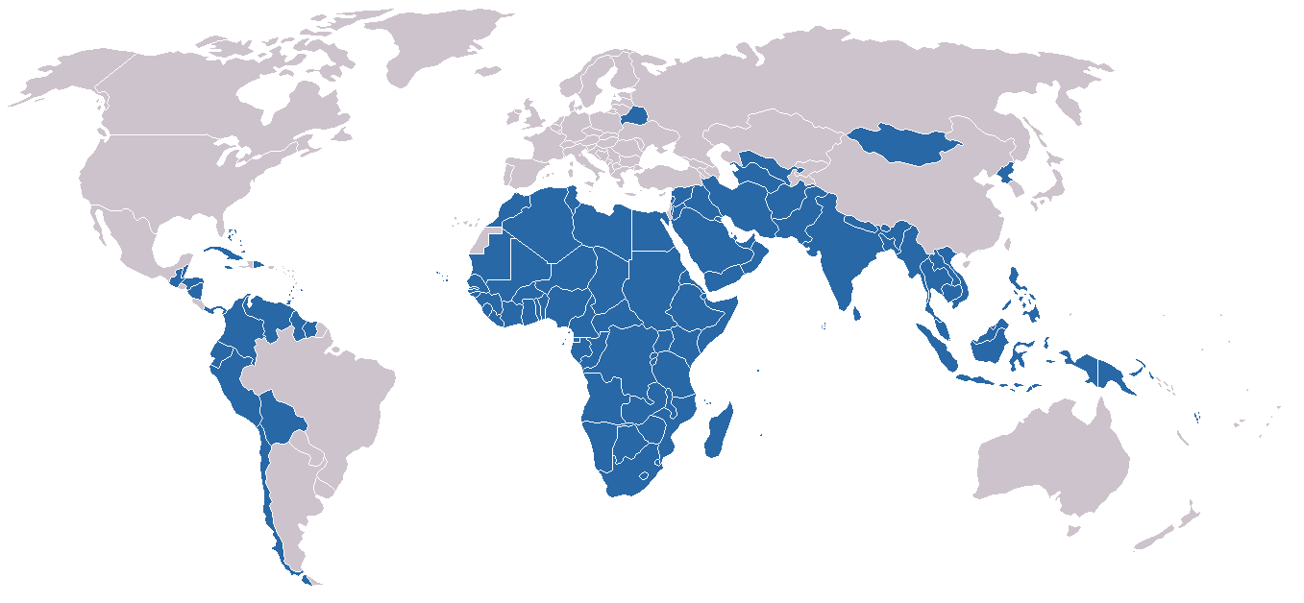
Creative or Radical Use of Security Council’s Mandate?
States’ Reactions: North and South Divide
Sanctions and Monitoring Cluster
Passed under Chapter VII, with only Security Council’s fifteen Member States vote, the Resolution mandated treaty-like obligations on all UN members to adopt and enforce effective laws to keep WMDs out of the hands of terrorists.
Technology Denial to Developing Countries
A number of states, especially in Non-Aligned Movement, expressed frustration over what they perceived to be a lack of balance between nonproliferation and disarmament in 1540. It was seen as a means of continuing technology denial to developing countries to the advantage of the wealthy industrialized North.
Created in 1961, NAM has sought to “create an independent path in world politics that would not result in member States becoming pawns in the struggles between the major powers.”
Source: NTI; Non-Alignment Movement
Image courtesy: Blank World Map Cities

Slide 7
1. Enforcement and Flexibility: 1540 is a NOT a Sanctions Committee
Limited country-centric efforts
Strategic Self Restraint
Efforts toward the Global South
Engaging in Dialogue, not investigations
Lack of legitimacy
Trust
Lack of capacity
Outreach and Marketing Activities: Raising Awareness
Outreach with Global South
Imprecise obligations
Considering the controversy sparked by the Resolution and some states’ resistance towards the Resolution, the Committee was under a political pressure to overcome these sensitivities and generate an enthusiasm towards 1540. It has exercised a reasonable degree of self-restraint in its early days.
Notes:
The 1540 Committee has been organized as a Special Political Mission under Sanctions cluster, but it did not choose to become a UN sanctions regime, either in the name of nonproliferation or counterterrorism. It adopted a cooperative approach to its work, exercised a self-restraint and tried to market the Resolution through outreach activities. Many practices of the Committee reflected a search for legitimacy rather than efficient implementation of the 1540’s goals. There were constant attempts to diffuse Member States’ fears in order to gain acceptance amongst them

Slide 8
The Achievements of Res. 1540 in 10 years.
Unprecedented Political Consensus.
The 2014 marked the 10th anniversary of the adoption of Res. 1540. Much has been accomplished for the past 10 years. Given States’ early apprehensions over Security Council’s reference to its Chapter VII powers in the adoption of UNSCR 1540, the high level of reporting is indeed remarkable. Some suggest that it serves as a metric to indicate an amplified worldwide commitment to UNSCR 1540 goals
176 National Reports
B
183 approved Matrices
57 outreach events in 2015
D
23 National Action Plans
145 average domestic measure
A
C
E
[W]hat was once seen as interference by the Security Council in domestic matters was now viewed as coming together of states for a common cause. The issues of the resolution’s legitimacy, which represented an early challenge to effective implementation, no longer existed.
Costa Rican Ambassador Jorge Urbina, 1540 Committee Chair, 1540 Comprehensive Review, 2011
.
Notes:
Nearly 90 percent of UN Member States have reported at least once to the 1540 Committee, 23 states shared their national implementation action plans and the 1540 Committee experts had at least 9 country visits.

Slide 9
The Achievements of 1540 as a Global Non-Proliferation Regime
The South African Case
The Caribbean Case
Peer Review Process
The Local Ownership
Reputational Costs
The Role of Regional Organizations
Inter-Agency Dialogue
The dual-use nature of the Resolution
The role of Regional Coordinator
National/Local Interests
Regional Champions
Lessons learnt from Croatia and Poland
Country Visits
The entrepreneur is commonly seen as an innovator a generator of new ideas and business processes.
Developing National Action Plans
Responding to local priorities and needs

Slide 10
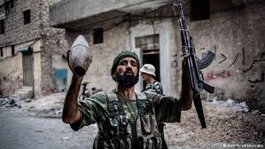
2. The Cost of the “Flexible” Mandate
The voluntary nature of Committee’s work has created unprecedented political consensus for the Resolution, but it affects the quality of domestic implementation. The Committee’s assistant-building mechanism has not been used very well to facilitate targeted technical assistance. The consensus-based setup of the Committee does not enable the 1540 Experts to conduct critical analysis of national reports or carry threat assessments and country profiling. Country Reports on implementation are false metric of Resolution’s success.
Roadblocks
Threat Assesment
Evolution of 1540
Valuntary Trust
Fund Managment
Universal Reporting
Assistance
Image courtesy: The Institute of Risk Management; BBC News Syrian Conflict; Investopedia.
Notes:
2004-2014: No major assistance request.
No Assistance Conference in first 10 years.
54 open assistance requests.
Diverging interpretation of what “assistance” is.

Slide 11
3. Towards Effective Global Non-Proliferation Regime
Reengineer the Group of Experts and their Work.
Establish long-lasting Private-Public Partnership.
Use academic institutions and organize policy labs to identify strategic gaps, organize knowledge around 1540 implementation and create user-friendly “ 1540 best-practices” digest.
Map Actors and Resources: Use technology to create a network
Prioritize regions & issue-areas: use empirical analysis
to organize outreach wisely.
Prioritize regional organizations and establish sustainable partnerships.
Addressing development—proliferation divide.
The US’s role in advancing 1540’s global role and domestic implementation.

Slide 12
Thank You!

