Slide 1
Examining Russian “Pre-Nuclear deterrence”
Harrison Menke
Menke007@live.missouristate.edu

Slide 2
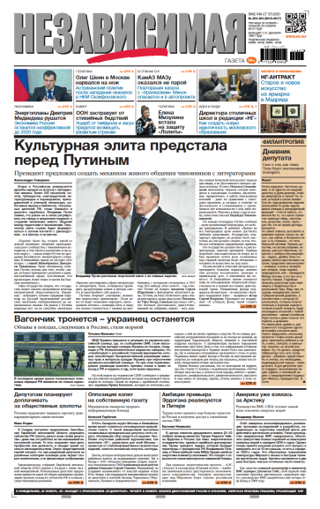
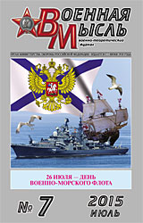
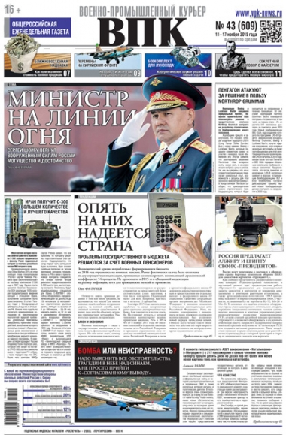
Introduction
Research Question: How will Russia seek to utilize long-range, non-nuclear weapons to manage escalation in the “pre-nuclear” phase?

Slide 3
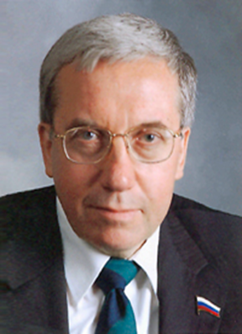
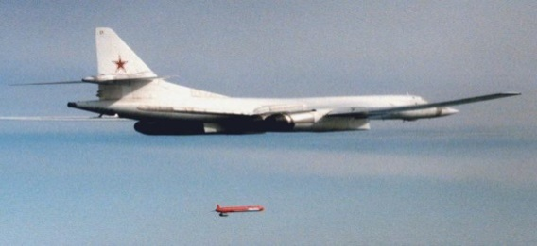
Conceptual Foundations
Russia understands nuclear weapons cannot be a panacea
Kokoshin and Pre-Nuclear Deterrence
Information Struggle

Slide 4
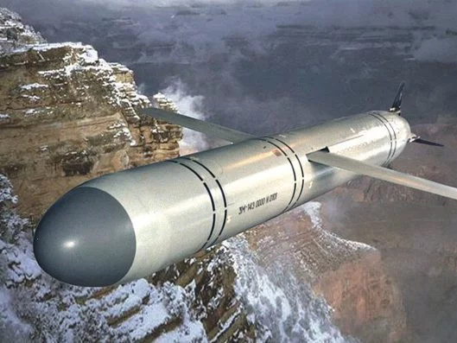
Goals, Targets, and Intentions
Early Stage: Targets Military Hubs and C2
As Escalation Continues: Targets Shift to Civilian Politico-Economic Infrastructure
Non-Nuclear De-Escalation?

Slide 5
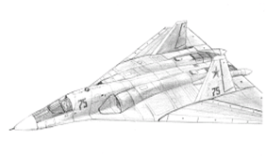
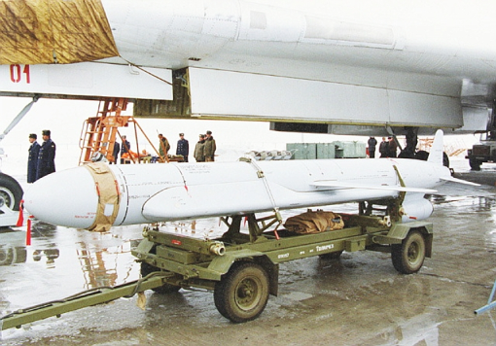
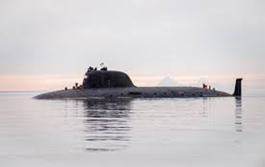
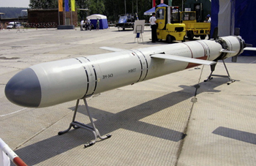
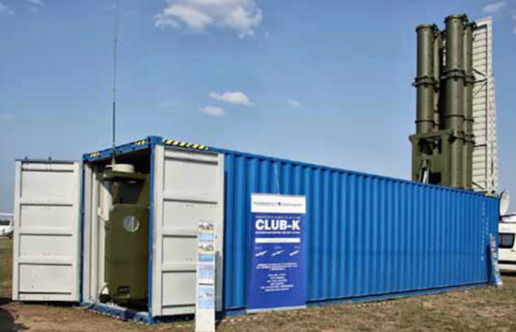
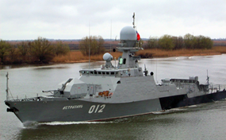
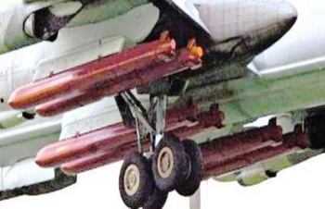
Kremlin Approval: Capabilities
New Strike Platforms
Improved Missiles
Leadership Views
“…Russia has the will to use them [Russia’s non-nuclear deterrent] if it satisfies the national interests of our state and our people.” –V.V. Putin
Notes:
Far Left:
Lada
Grigorovich-class
Yasen
Buyan-M (Bottom)
Demonstrate a Russian commitment to nonnuclear deterrenc

Slide 6
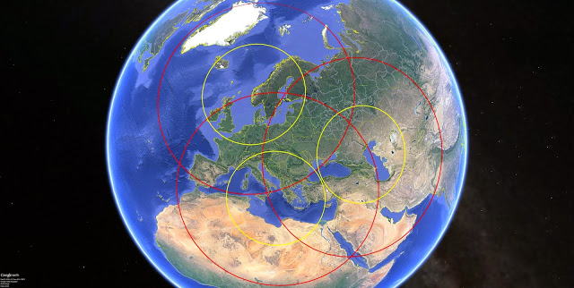
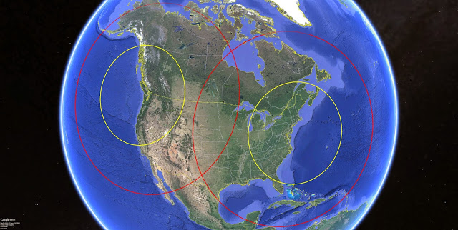
Naval Launch Point Coverage
Yellow Rings: 1,300 km Red Rings: 3,000 km
Russian reports suggest Kalibr cruise missiles could range between 1,500-3,000 km Kh-101 ALCM is reported to be around 5,000 km
*Maps from 7 Fee Beneath the Keel, “The RF Navy vs Your ‘Critically Important Facilities,” March 29, 2015.
Notes:
Below are nine maps depicting approximate range rings for an SS-N-30A launch platform (ship or submarine) operating in various areas of the world. The yellow and red rings depict 1,300km/700nm (conventional) and 3,000km/1,620nm (nuclear) ranges, respectively. The launch points chosen are not meant to suggest actual planned launch areas, but simply to provide a sense of LACM coverage.

Slide 7
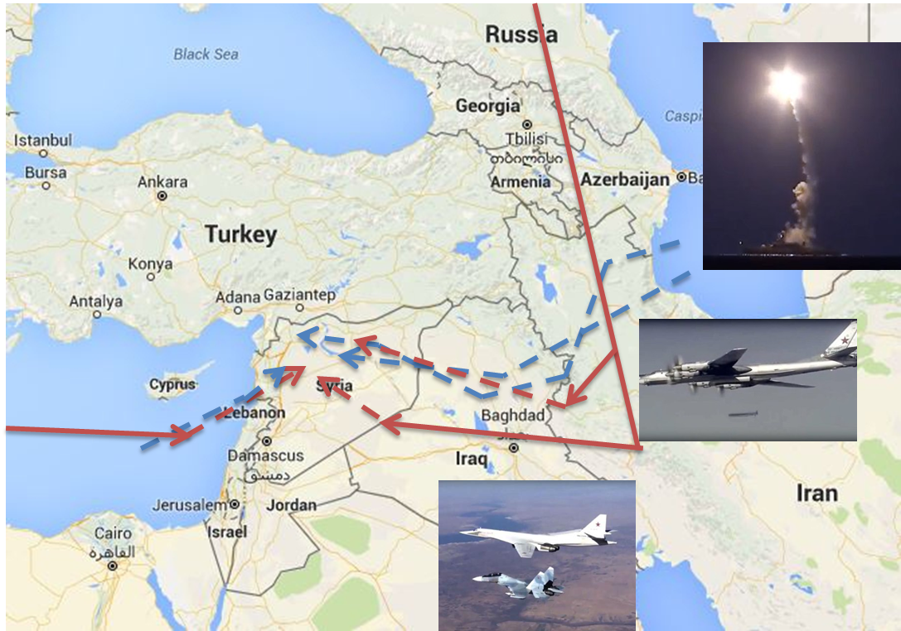
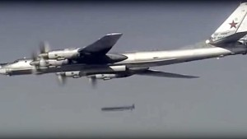
The Syrian Testing Ground
Russian Cruise Missile Launches
*Map partly from The Aviationist, “This Infographic Provides All the Details About the Russian Strategic Bomber Fleet Operations Over Syria,” Nov. 21, 2015.
Notes:
“…Russia has the will to use them [Russia’s non-nuclear deterrent] if it satisfies the national interests of our state and our people.” –V.V. Putin

Slide 8
Implications
A New Coercive Toolkit
Weakens Traditional Conventional-Nuclear Firebreaks
Strategic Effects without Crossing the Nuclear Threshold
Likely to Encourage Escalation and Crisis Instability

