Slide 1
A Nuclear Procurement Channel for Iran
April 2016
Mission Impossible?
Michele Capeleto, Naval Analyst
+44 020 325 32137
Michele.Capeleto@ihs.com

Slide 2
A Nuclear Procurement Channel for Iran Overview – Presentation Structure
Recent Developments
Key Scenarios
Defining the Channel
Controlled Items
Oversight of the Channel
Procedural Issues
Final Remarks

Slide 3
A Nuclear Procurement Channel for Iran Recent Developments
Recent Developments
Implementation
Day
Key Scenarios
2025
Defining the Channel
Adoption
Day
Controlled Items
UNSCR
2231
2015
Oversight of the Channel
JCPOA
Procedural Issues
Final Remarks

Slide 4
A Nuclear Procurement Channel for Iran Key Scenarios
Recent Developments
- Lifted sanctions are ‘secondary’ sanctions
- US persons still face huge business limitations
- Civil aviation; US-owned Foreign Entities; import of certain Iranian products.
- US secondary sanctions no longer applicable
- Greater risk of non-compliance
- Terminated most trade & financial restrictions
- US secondary sanctions no longer applicable
Key Scenarios
Defining the Channel
Controlled Items
Oversight of the Channel
Procedural Issues
Final Remarks

Slide 5
A Nuclear Procurement Channel for Iran Defining the Channel
Recent Developments
Prior Approval
Nuclear relevant items
Procedures
Legitimate Export
Key Scenarios
Defining the Channel
PROCUREMENT CHANNEL
Controlled Items
Oversight of the Channel
Procedural Issues
Final Remarks

Slide 6
A Nuclear Procurement Channel for Iran Controlled Items
Recent Developments
WHAT IS COVERED?
Key Scenarios
NSG Trigger List
Defining the Channel
CONTROLLED ITEMS AND ACTIVITIES
Controlled Items
NSG Dual-use List
Oversight of the Channel
Catch-all Clause
Procedural Issues
?
Final Remarks

Slide 7
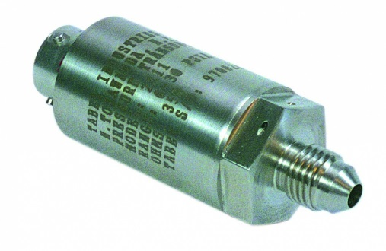
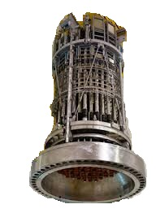
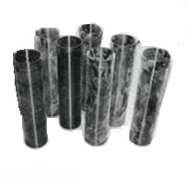
A Nuclear Procurement Channel for Iran Controlled Items – The ‘Catch-all’ Provision
Recent Developments
“ With the purpose of establishing a procurement channel, […] the Joint Commission will […] review and decide on proposals by states seeking to supply [items listed in the NSG Lists], as well as any further items if the relevant State determines that they could contribute to activities inconsistent with the JCPOA”
Key Scenarios
Defining the Channel
Controlled Items
Oversight of the Channel
Procedural Issues
Final Remarks

Slide 8
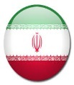
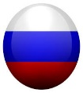
A Nuclear Procurement Channel for Iran Oversight of the Channel
Recent Developments
UNSC
Key Scenarios
Defining the Channel
Joint Commission / PWG
Controlled Items
Oversight of the Channel
Procedural Issues
Exporting
State
Final Remarks

Slide 9
A Nuclear Procurement Channel for Iran Procedural Issues
Recent Developments
Application
Form
End-use
Certificate
Additional Supporting
Documents
Key Scenarios
Defining the Channel
Controlled Items
Oversight of the Channel
How detailed a description?
Procedural Issues
Translation/language issues
EUC for dual-use, non-nuclear end-use
Final Remarks

Slide 10
A Nuclear Procurement Channel for Iran Final Remarks
Recent Developments
MULTIPLE SANCTIONS REGIMES
Key Scenarios
Defining the Channel
IRAN’S PAST EFFORTS
Controlled Items
Oversight of the Channel
Procedural Issues
CLEARER APPROVAL / DENIAL CONDITIONS
Final Remarks

Slide 11
A Nuclear Procurement Channel for Iran Final Remarks
Recent Developments
END-USE CHECKS
Key Scenarios
Defining the Channel
DISPUTE SETTLEMENT
Controlled Items
Oversight of the Channel
Procedural Issues
DATA STANDARDISATION
Final Remarks

Slide 12
Michele Capeleto, Naval Analyst +44 020 325 32137 Michele.Capeleto@ihs.com
THANK YOU FOR YOUR ATTENTION!

