Slide 1
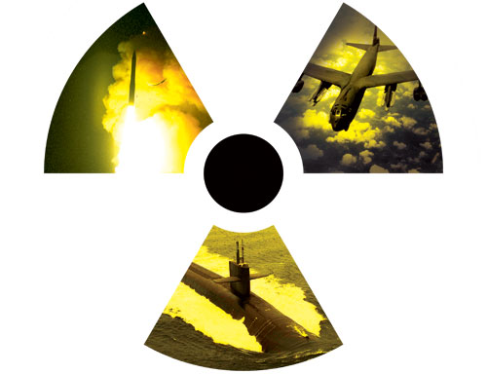
Dime Store Deterrence
Getting What You Pay For
Evan M. Thompson
Research Associate, CBRN
Octant Associates, LLC
ethompson@octantassociates.com

Slide 2
Costing Nuclear Modernization
Investment Over Next 30 Years
Ohio Class SSBN Replacement ($102 billion)
ICBM Follow-On ($20-120 billion)
Long Range Strike Bomber ($100 billion)
Nuclear Air-Launched Cruise Missile (LRSO) ($20 billion)
B61 Gravity Bomb Life Extension ($13 billion)
O&M for next 30 years
Current Triad, C&C, NNSA Activities ($727 billion)
Total: ~$1.082 trillion

Slide 3
DoD Strategic Nuke Funding: Constant Dollars
Funding far below historical levels
Only 5% of spending at peak bow wave
Investment Average (FYDP) = $5.7B
Recapitalization
Total Funding (Billions of FY12$)
New NAOC
New ICBM
New cruise missile
New SLBM?
Investment
New Bomber
New SSBN
Operations & Support
SSBN = ballistic missile submarine; NAOC = National Airborne Operations Center; SLBM = submarine-launched ballistic missile; New ICBM, New NAOC, and New SLBM are unfunded

Slide 4
Ohio Replacement
How to Cut Costs?
The Cost of Cutting Costs?
Cut procurement to 8 submarines
Estimated savings of $16 billion over 10 years (16% savings)
Cut procurement to 10 submarines
Estimated savings of $17 billion in 2030s (16% savings)
Phase out oldest SSBNs early
Estimated savings of $37 billion (36% savings)
Smaller enemy target set
Less range coverage
Smaller fleet taxes individual boats
Early phase out would strain fleet in the interim- generate increased risk

Slide 5
ICBM Follow-ON
How to Cut Costs?
The Cost of Cutting Costs?
Delay development by 5 years
Estimated savings of $20.6 billion over 20 years (17% saving)
Delay development and cut force size by 150 missiles
Estimated savings of $31 billion over 20 years (26% saving)
Refurbish existing ICBMS
Estimated savings of $16 billion over 20 years (13% saving)
Cut ICBM leg
Estimated savings of $120 billion over 20 years (100% saving+O&M costs)
Delays would put considerable strain on a platform that is already aging and approaching end of life
Cutting force size would reduce the survivability of arsenal- fewer targets
Weakens the most stable leg of triad
Making cuts in the leanest, most affordable leg of the triad

Slide 6
Long-Range Strike Bomber
How to Cut Costs?
The Cost of Cutting Costs?
Delay production for 10 years
Estimated cost savings of $32 billion (32% saving)
Continued reliance on aging systems with limited capabilities
Will not be able to penetrate sophisticated air defenses without a modern bomber force
Delay in development would result in a delay in much-needed conventional capabilities as well- hampers power projection
Delay may create higher costs in long-term

Slide 7
Long Range Standoff
How to Cut Costs?
The Cost of Cutting Costs?
Cancel the LRSO development
Estimated savings of $20 billion (100% savings)
Loss of standoff capability as current ALCM ages out
Sacrificing B-52 nuclear capability
Necessitates greater risk for B-2 or LRS-B as vulnerability to sophisticated air defense increases

Slide 8
B61 Life Extension
How to Cut Costs?
The Cost of Cutting Costs?
Scale back B61 life extension by removing consolidation and avoid replacing non-essential non-nuclear components
Estimated cost savings of $4 billion (20% saving)
Forced reliance on an aging delivery system
Sacrificing the dual-capability of aircraft and flight crews and the F-35 dual capability
Attrition of national lab capability as they are required to perform a smaller role in modernization
Demonstrates an apparent lack of commitment to modernization that weakens assurance to allies

Slide 9
Total Costs of cutting Nuclear modernization
Sacrificing survivability and effectiveness of nuclear arsenal- a weakened deterrent and the appearance of it!
Many suggestions for cost saving involve costly delays and smaller numbers
Many suggestions for cost saving involve accepting deteriorating capabilities
Losing comparative advantage against adversaries with growing arsenals and capabilities- nuclear and conventional!
Attrition of skills and knowledge pool in warhead development and maintenance
Marginal savings by making suggested cuts
At its peak, nuclear modernization will only account for 5% of budget
As long as we maintain an arsenal the costs will have to come eventually and delays will make it cost more
Creates the perception of a lack of commitment to the nuclear mission, waning trust in the nuclear umbrella, and creates incentive for nuclear development in allies

Slide 10
Where to cut Defense Instead?
DOD Infrastructure
$800 billion in facilities worldwide- time to BRAC!
Costs rising for maintaining and upgrading infrastructure
Army facility capacity is 18% greater than needed
Air Force facility capacity is 30% greater than needed
MilPers
Highest costs and rising
Rising real healthcare costs
Rising general healthcare costs
Expanded coverage in procedures
Shrinking premiums
Higher than inflation pay raises

